Slide 1
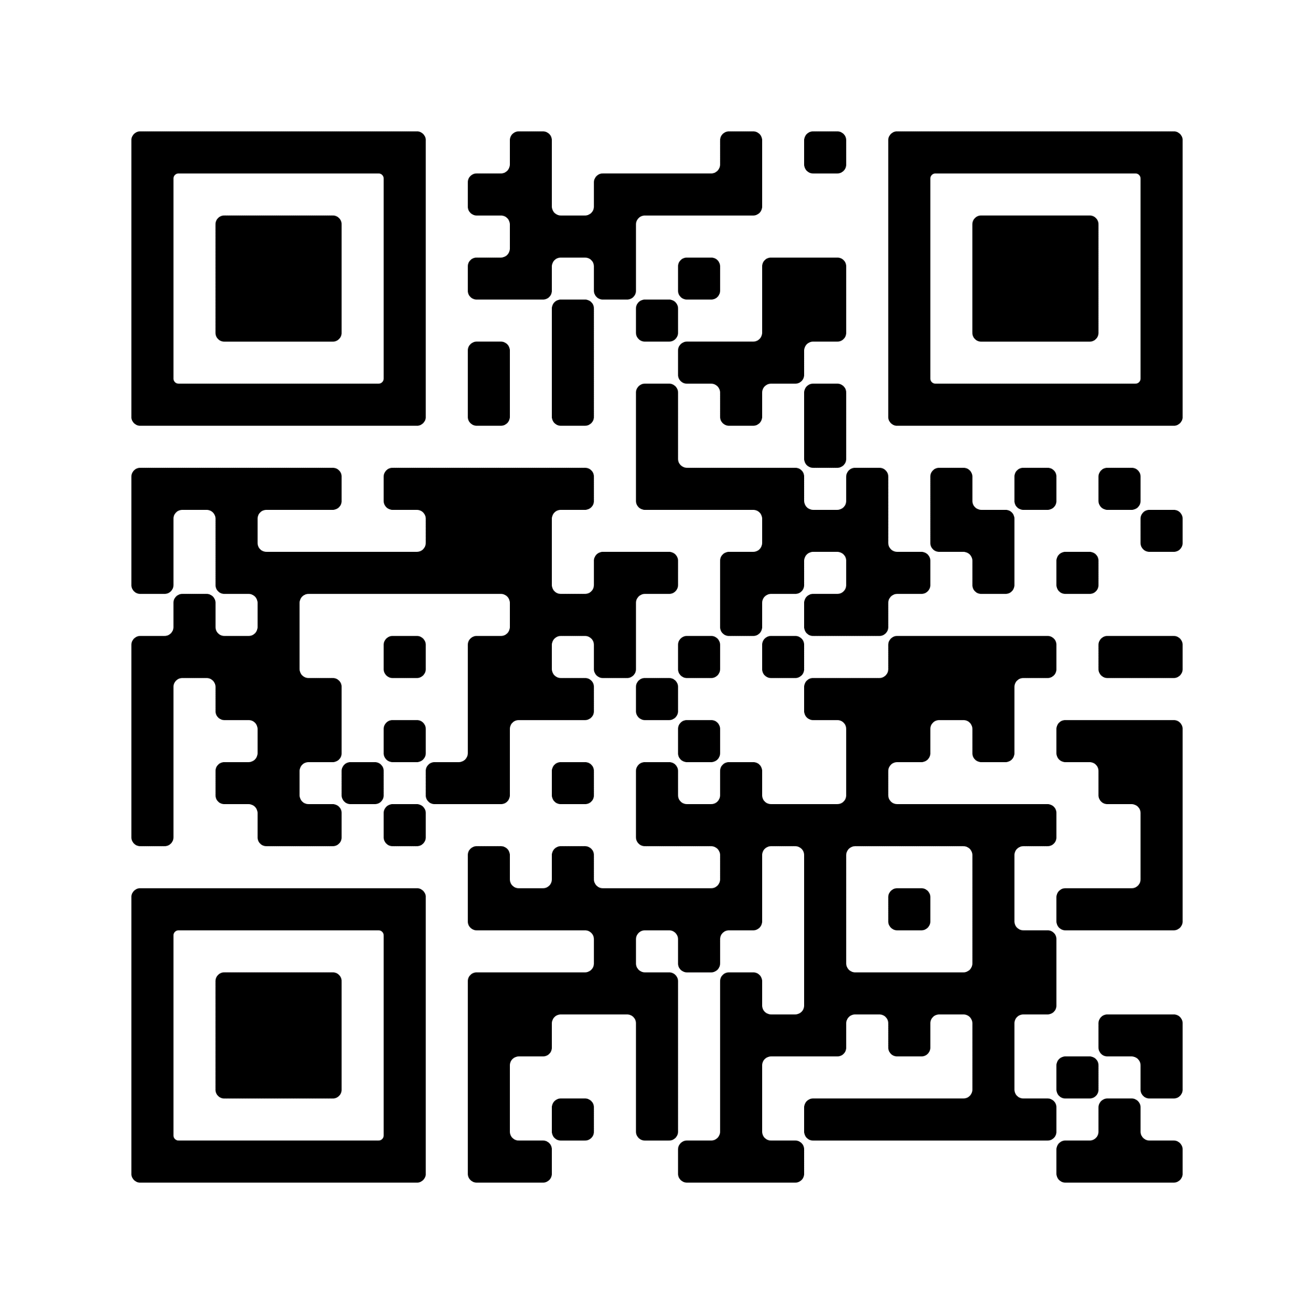
Hurricanes Helene and Milton Response
Hurricanes Helene and Milton hit the coast of Florida within weeks of each other as powerful and devastating storms impacting states across the Southeast. With your help, Lutheran Disaster Response will continue to be there to support people affected by Milton, Helene and any other storms that may strike this season.
Gifts to Lutheran Disaster Response equip us to respond to these disasters and others, whenever and wherever they strike.
Scan the QR code to give today.
By giving to Lutheran Disaster Response, you make it possible for the ELCA to act quickly after disasters such as Hurricane Helene and remain for as long as the recovery takes.

