Slide 1
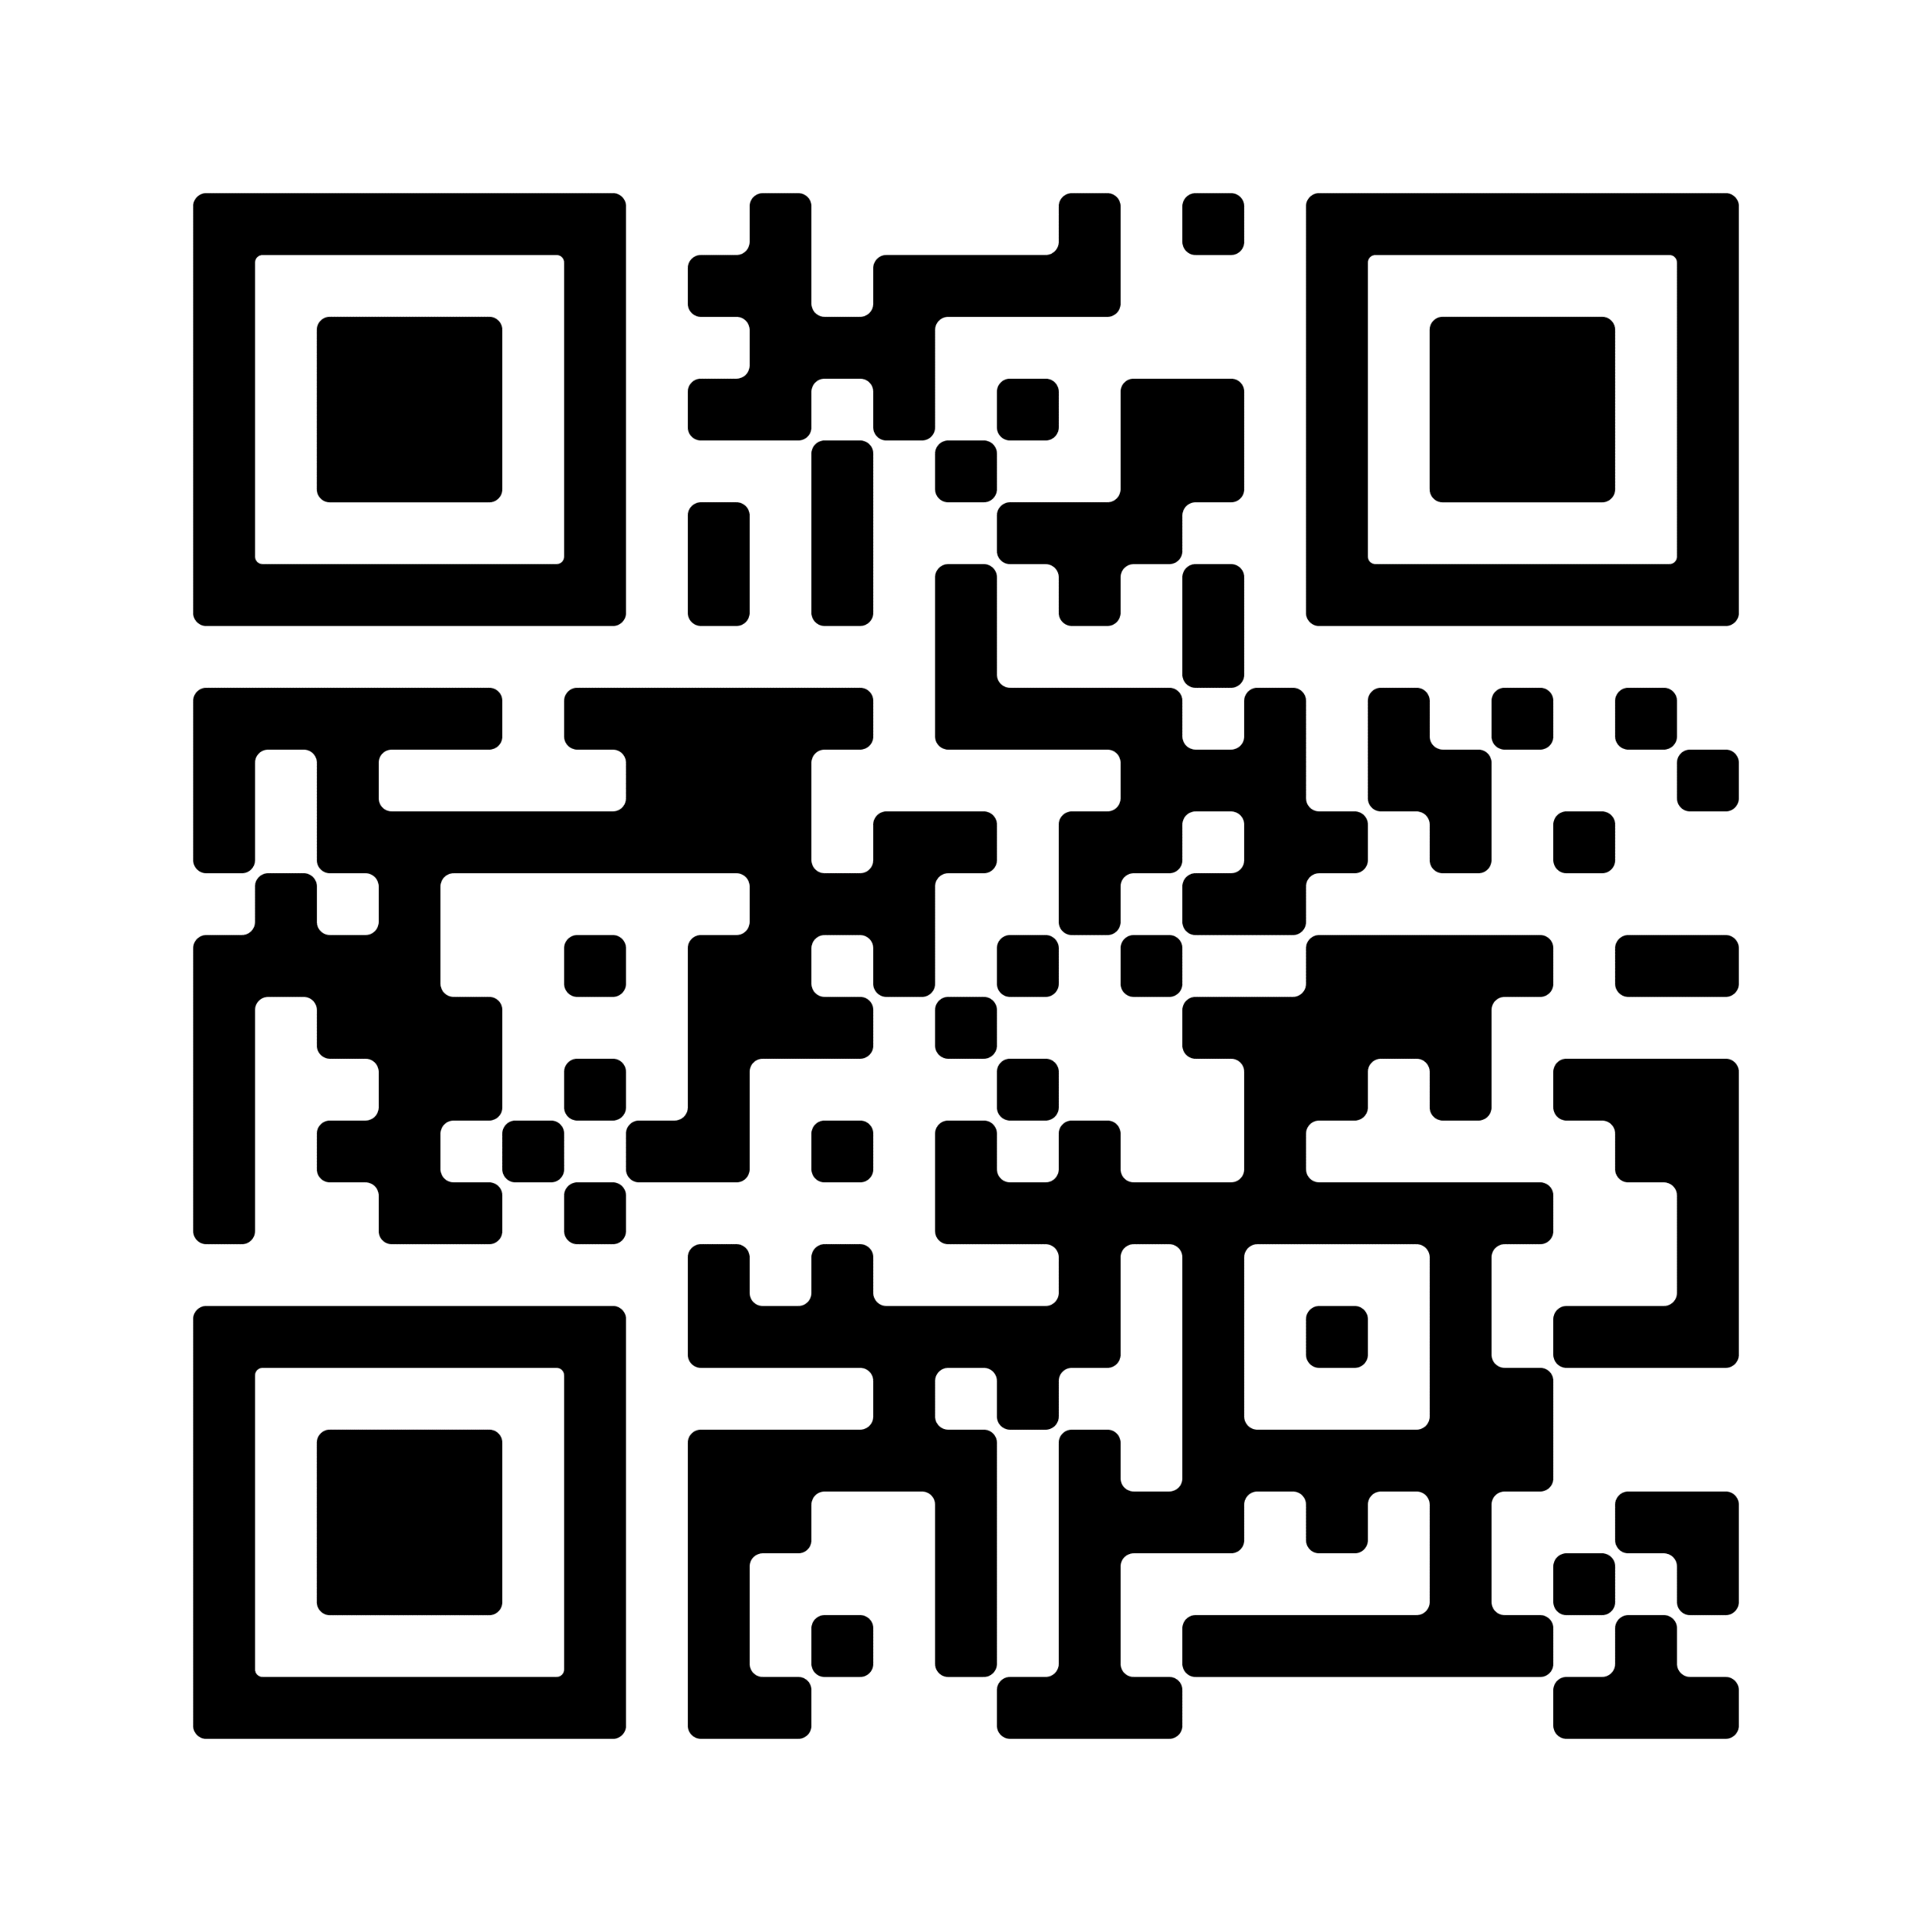
Lutheran Disaster Response: Hurricane Helene
Hurricane Helene hit the coast of Florida as a devastating Category 4 hurricane and moved inland as a tropical storm through the southeastern United States. Millions are without power as heavy rains continue to fall, causing dangerous flooding and landslides, as well as downed trees and power lines.
Wherever this storm goes, Lutheran Disaster Response will be there.
Scan the QR code to give today.
By giving to Lutheran Disaster Response, you make it possible for the ELCA to act quickly after disasters such as Hurricane Helene and remain for as long as the recovery takes.

