Slide 3
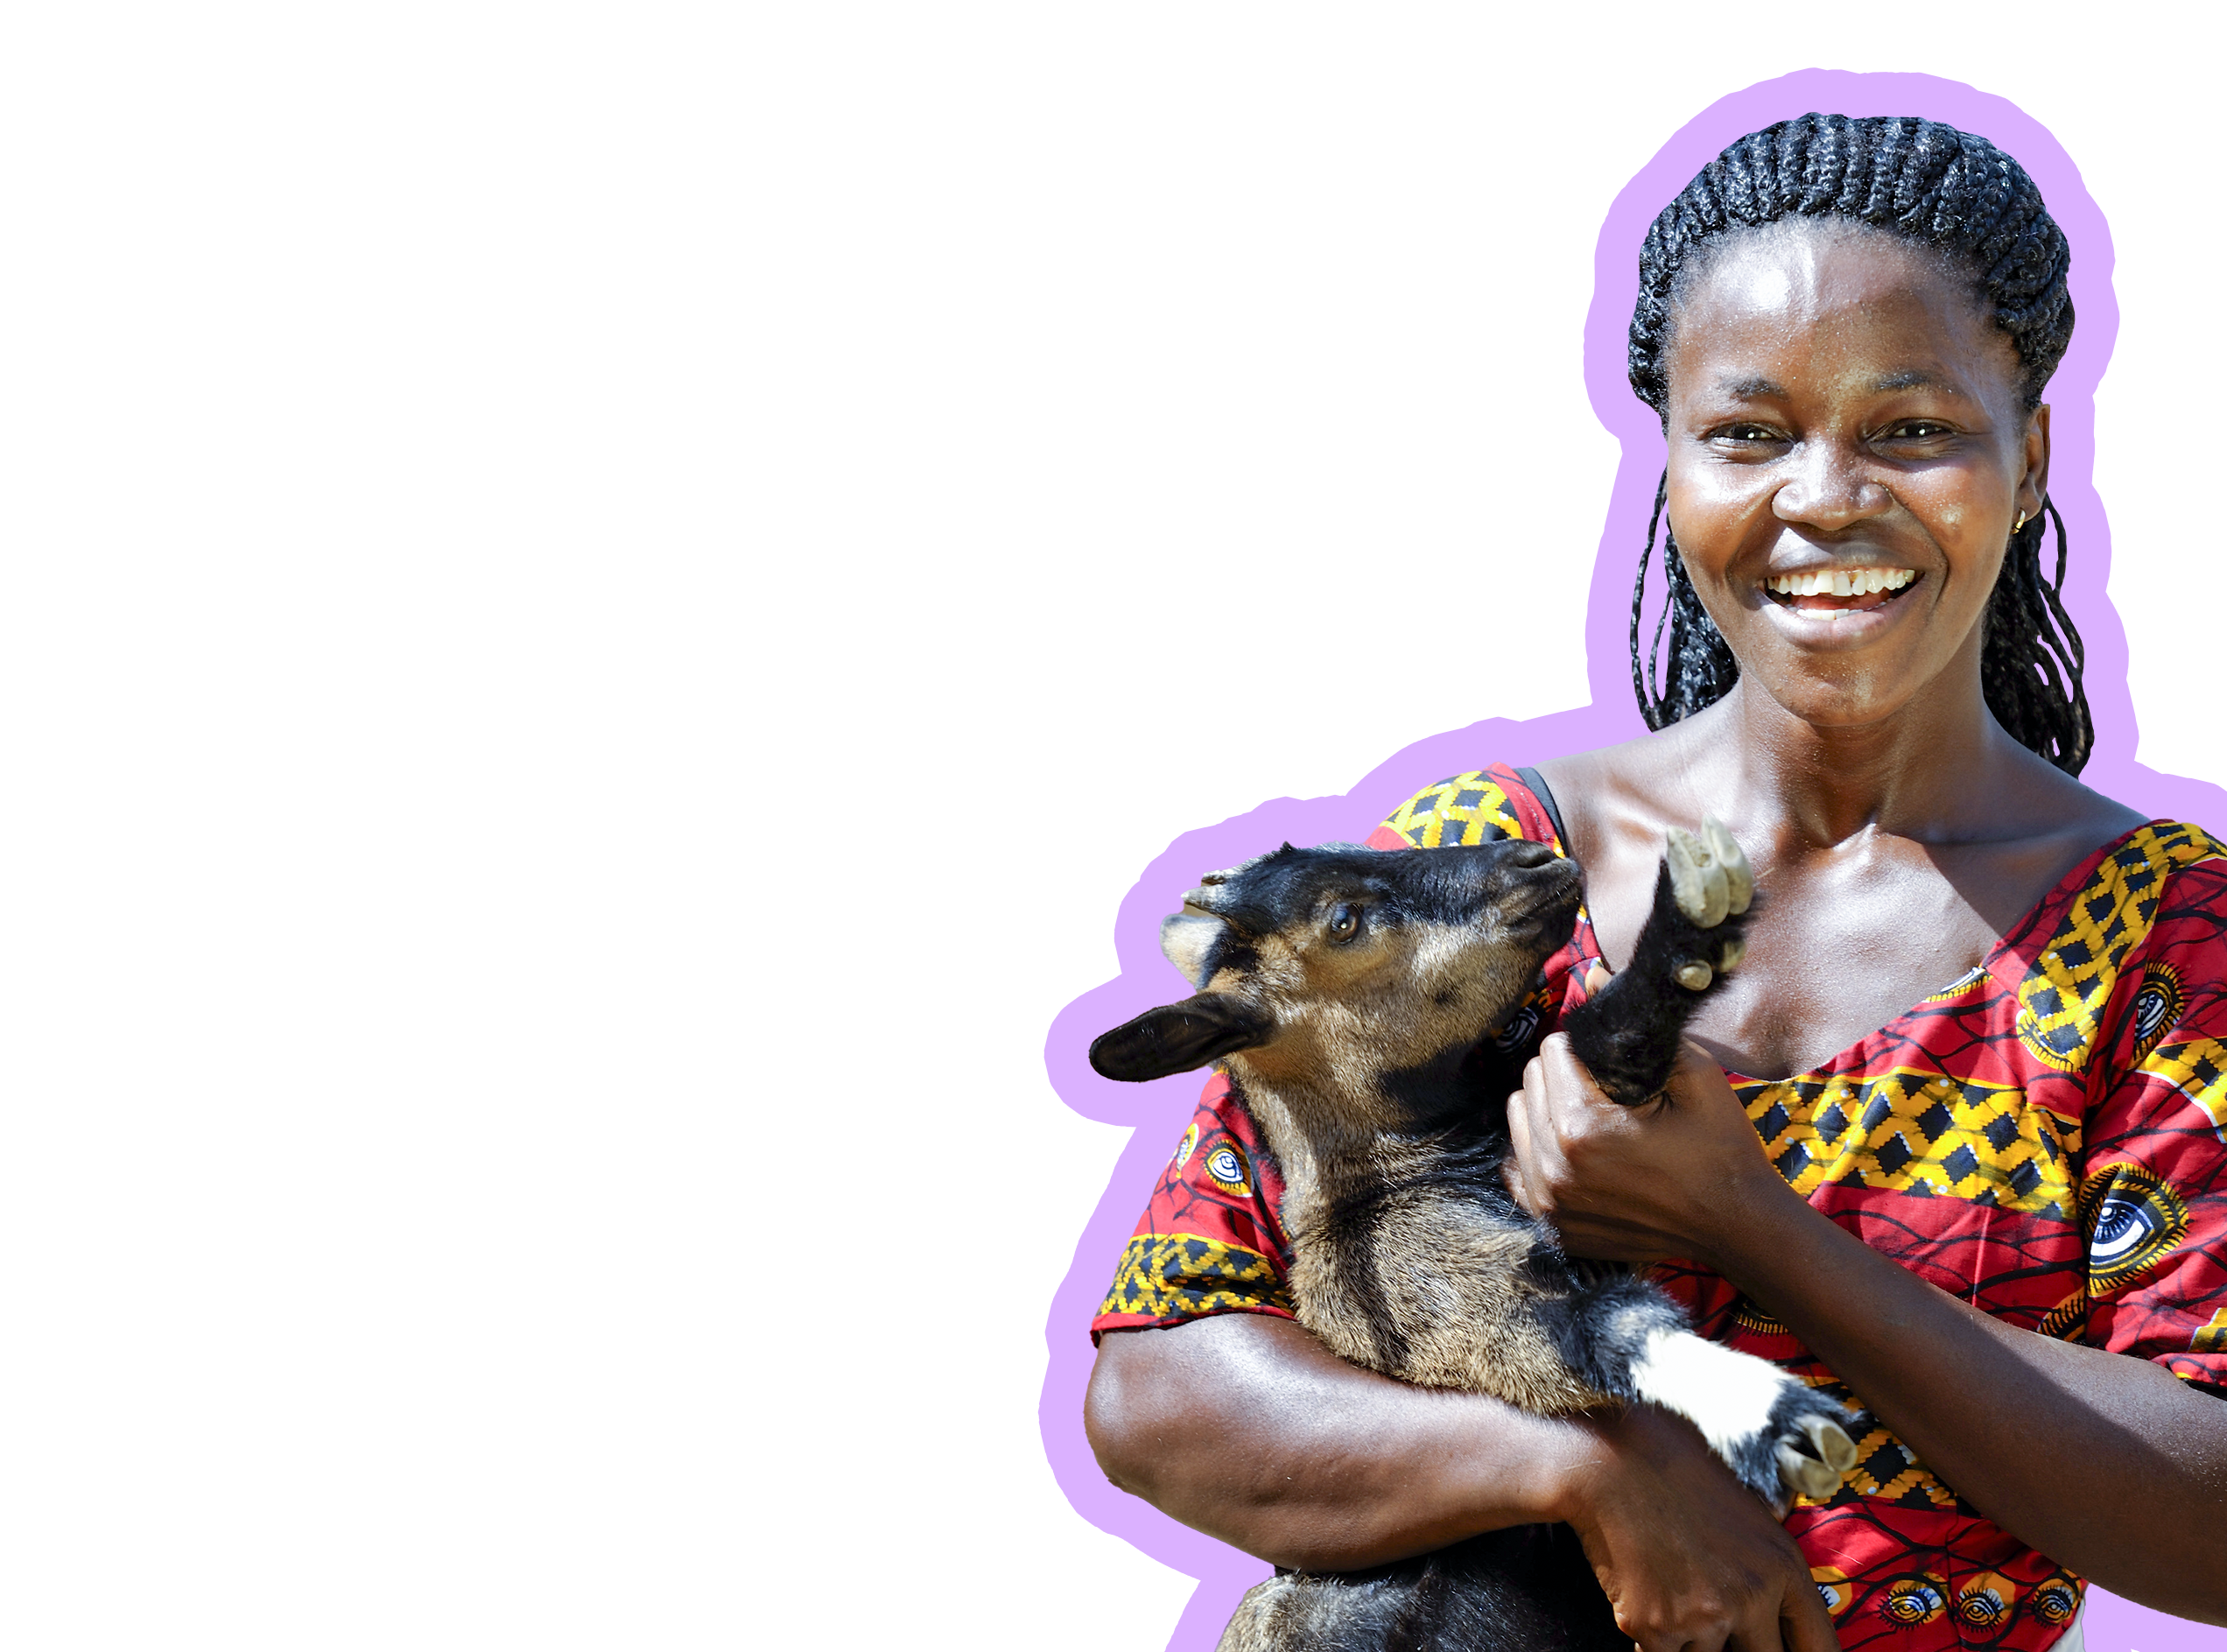
Paul Jeffrey/Life on Earth

Slide 4
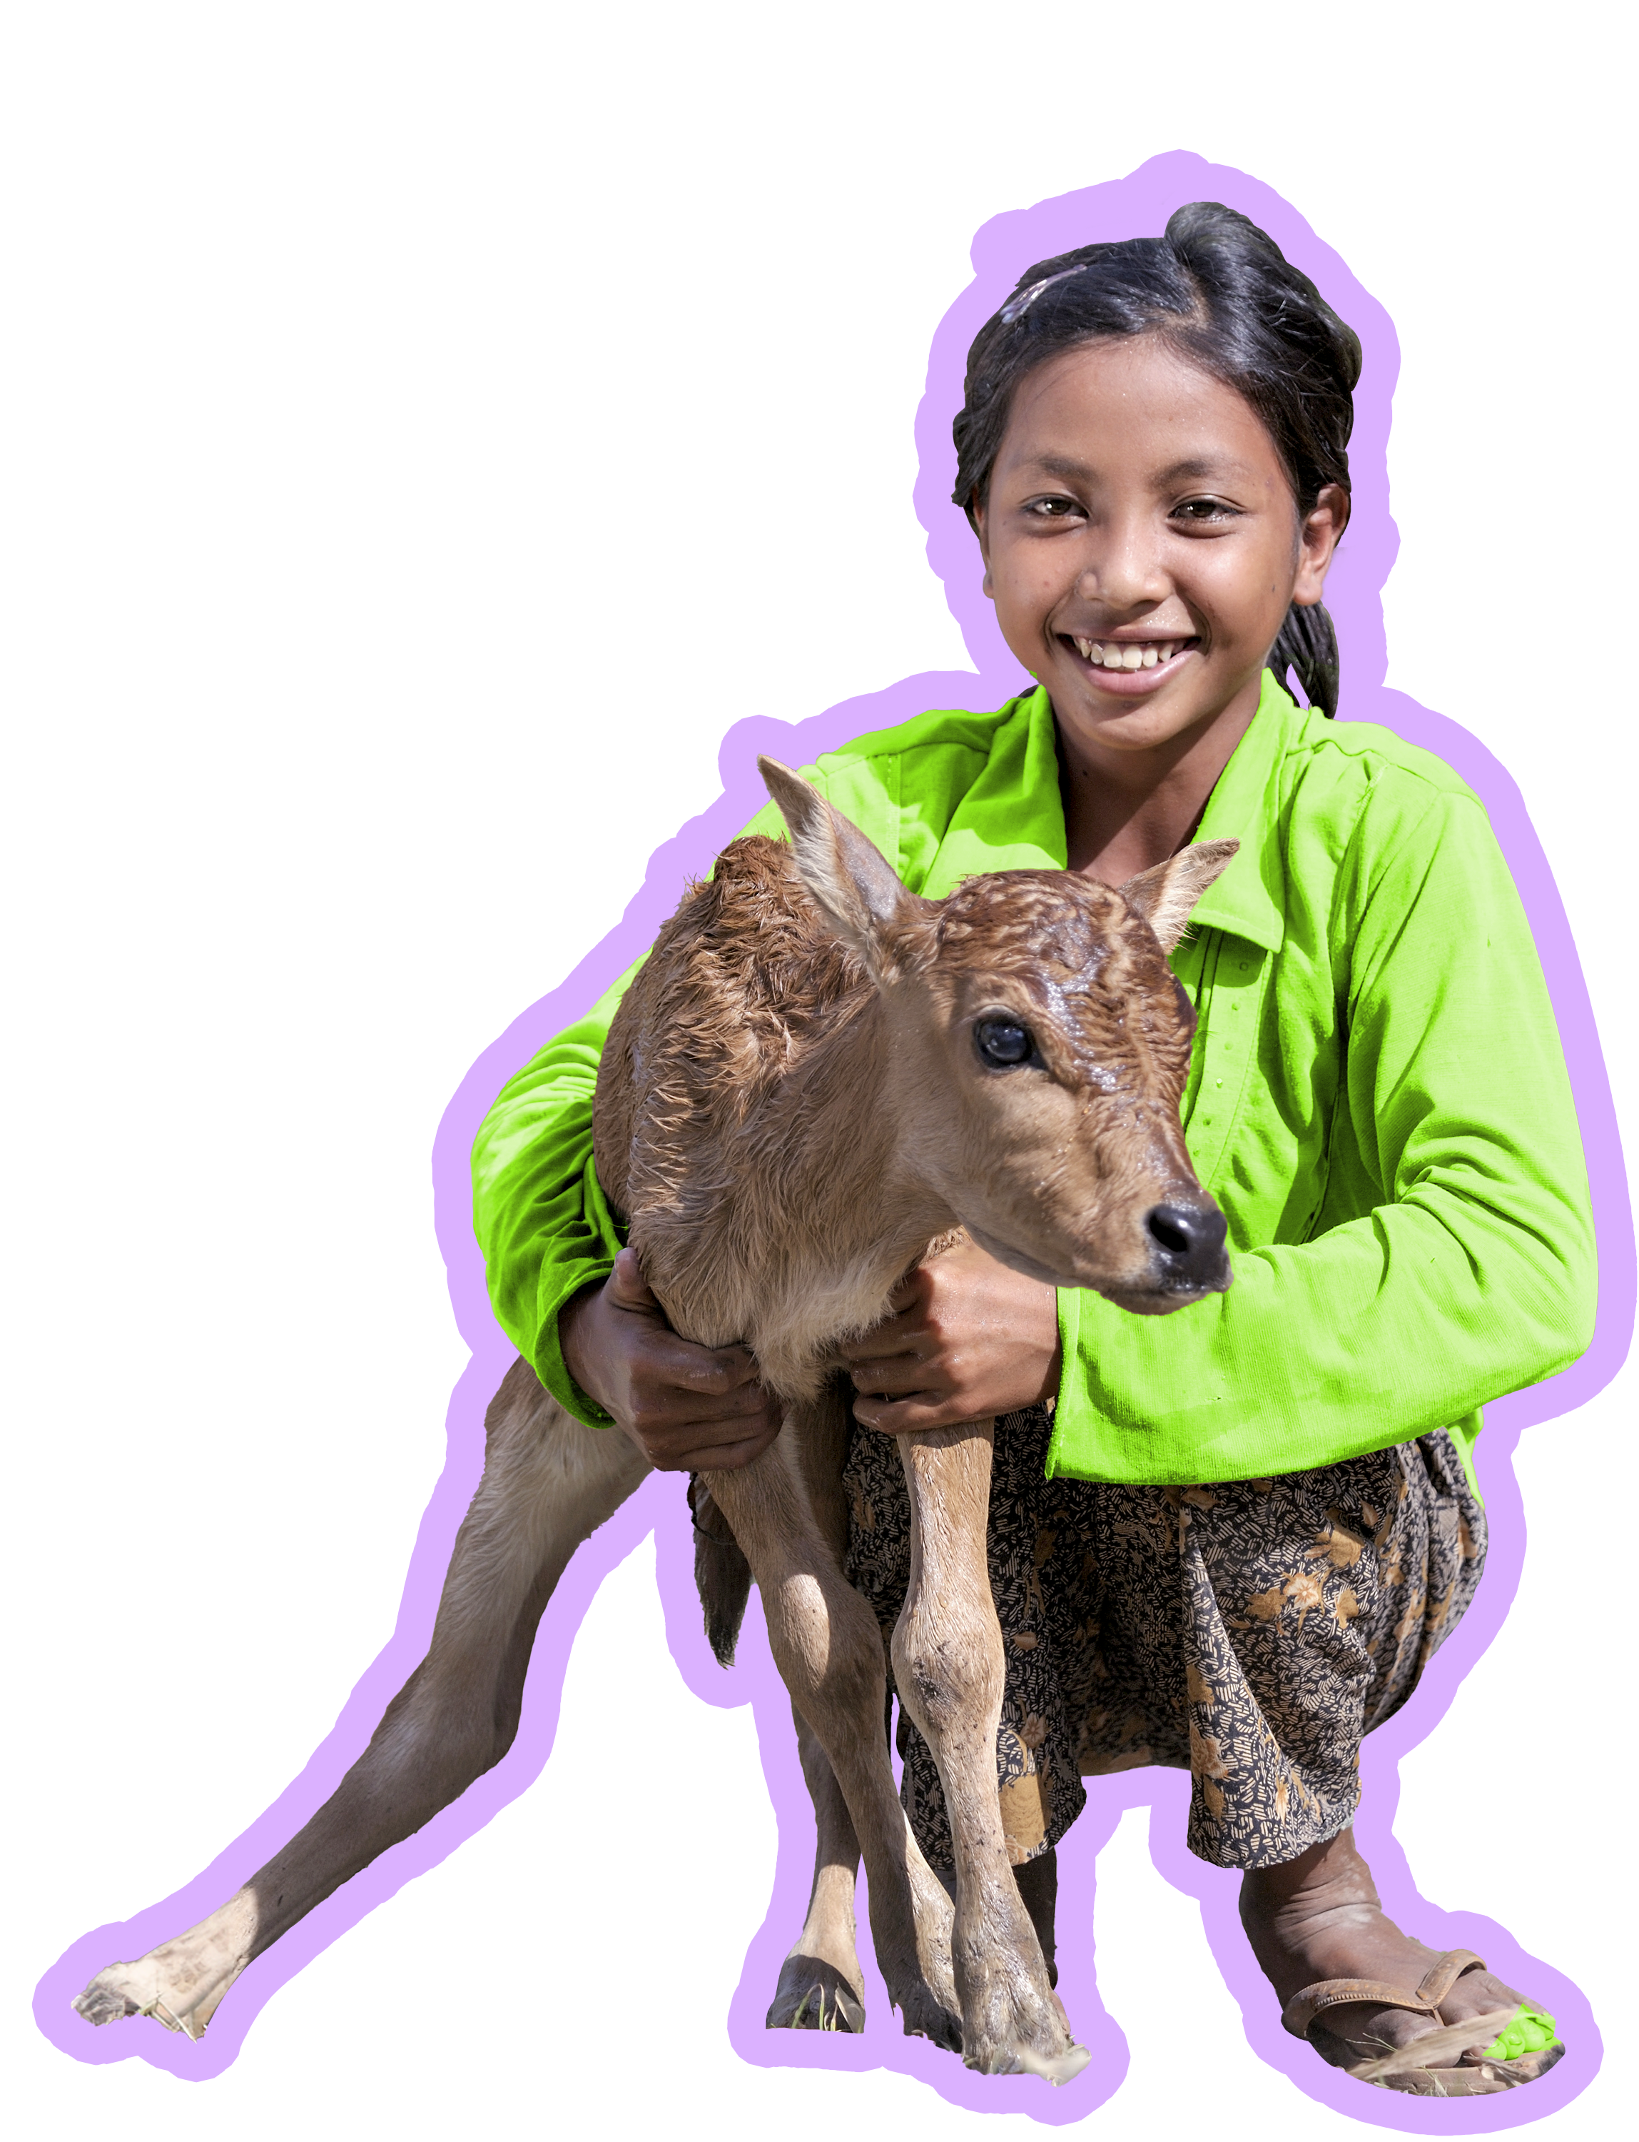
Paul Jeffrey/Life on Earth

Slide 5
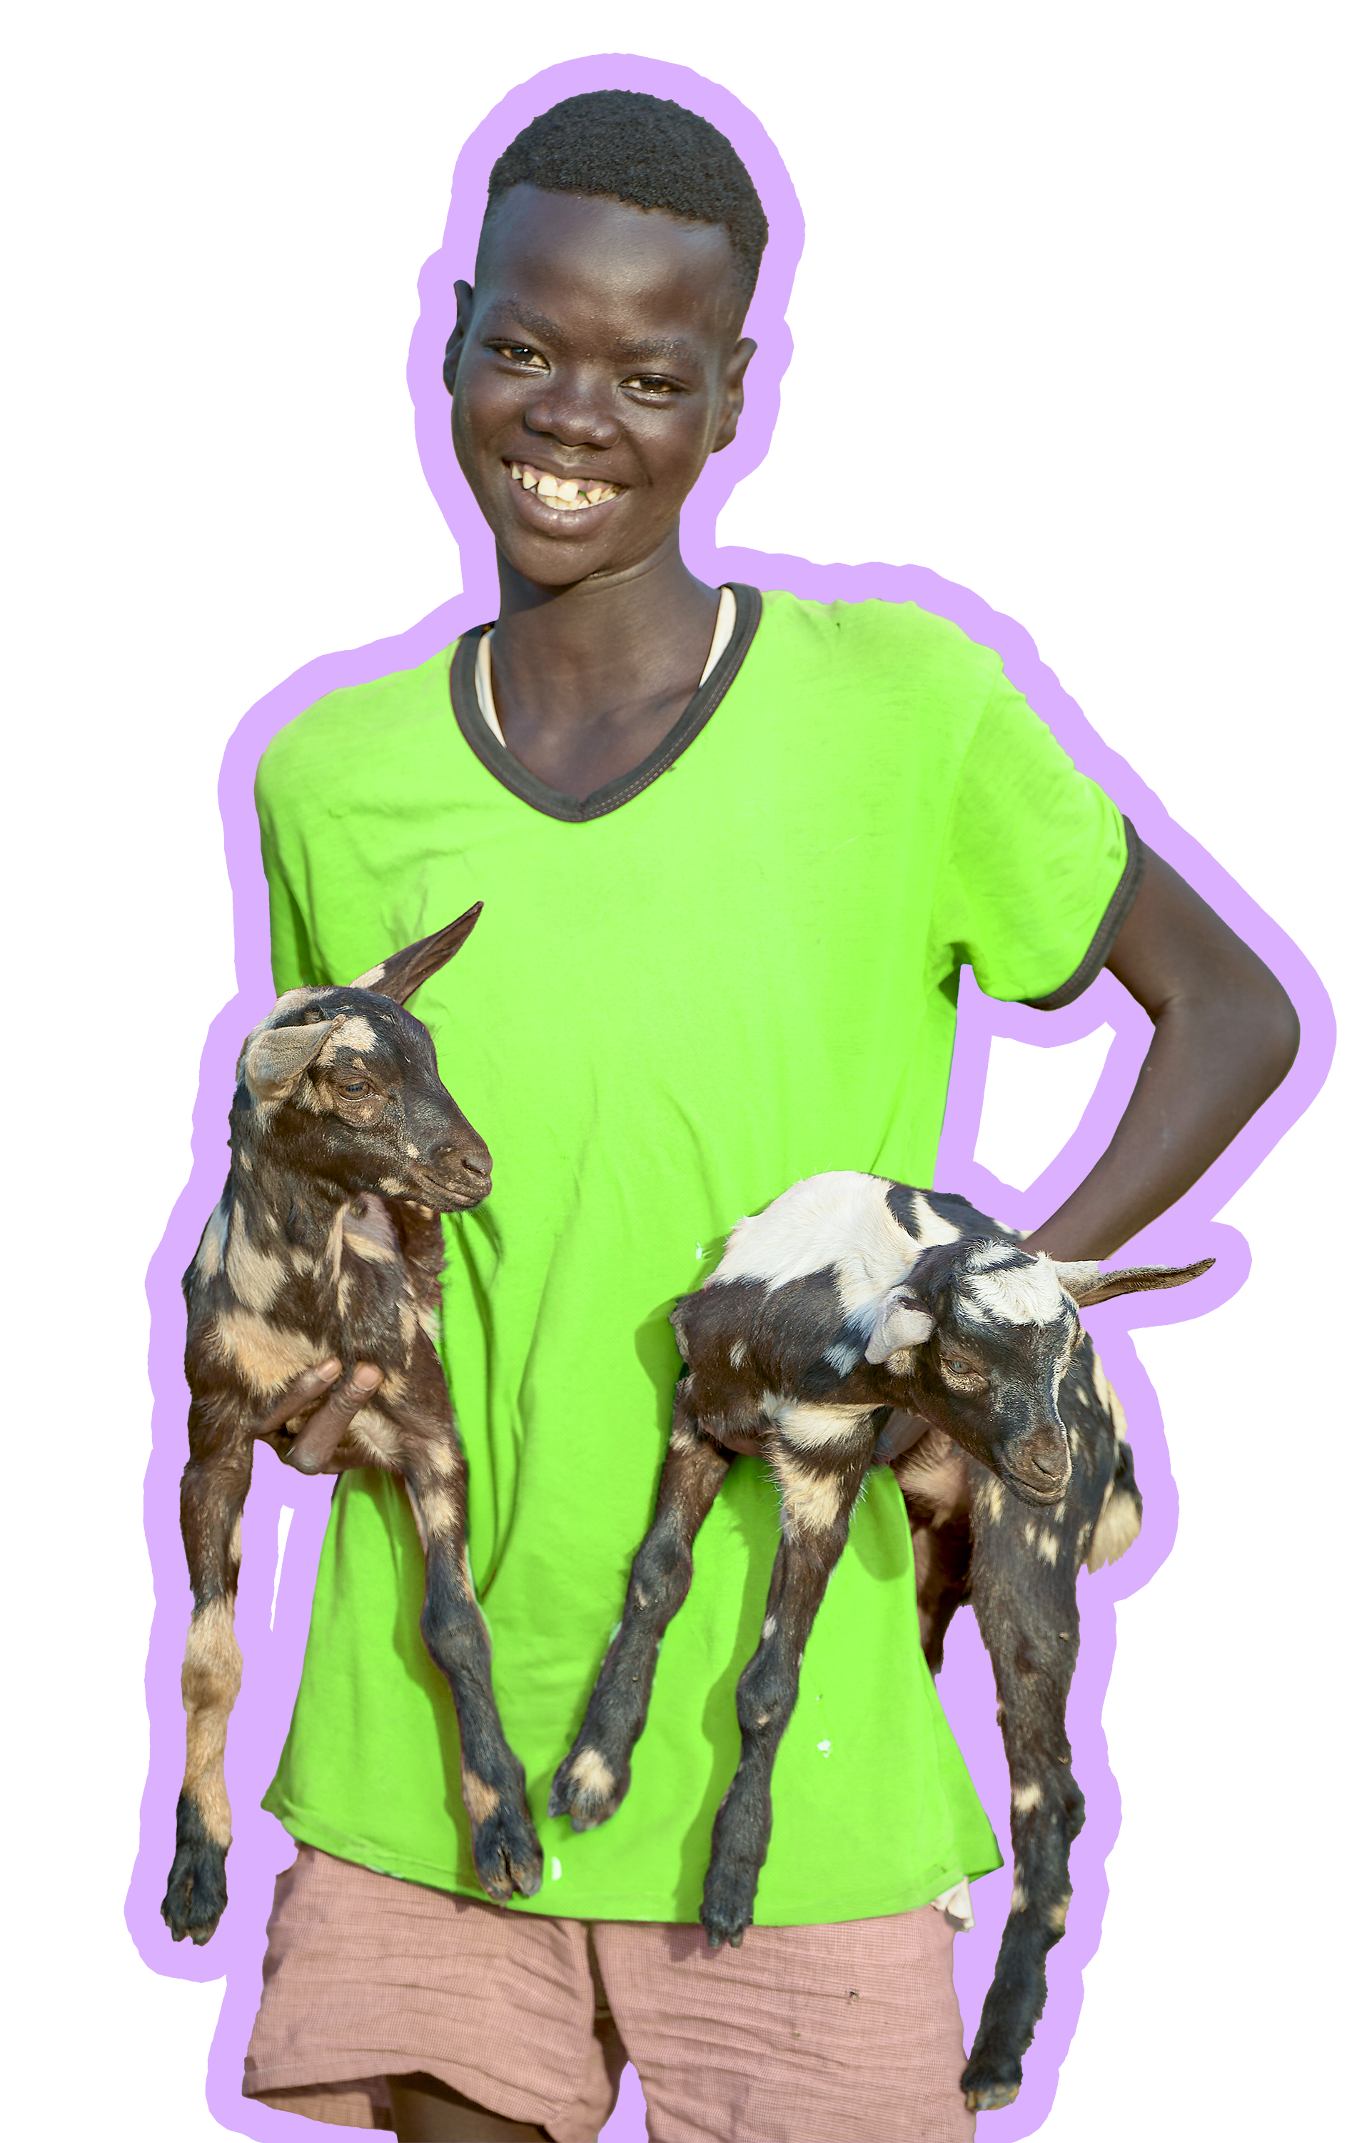
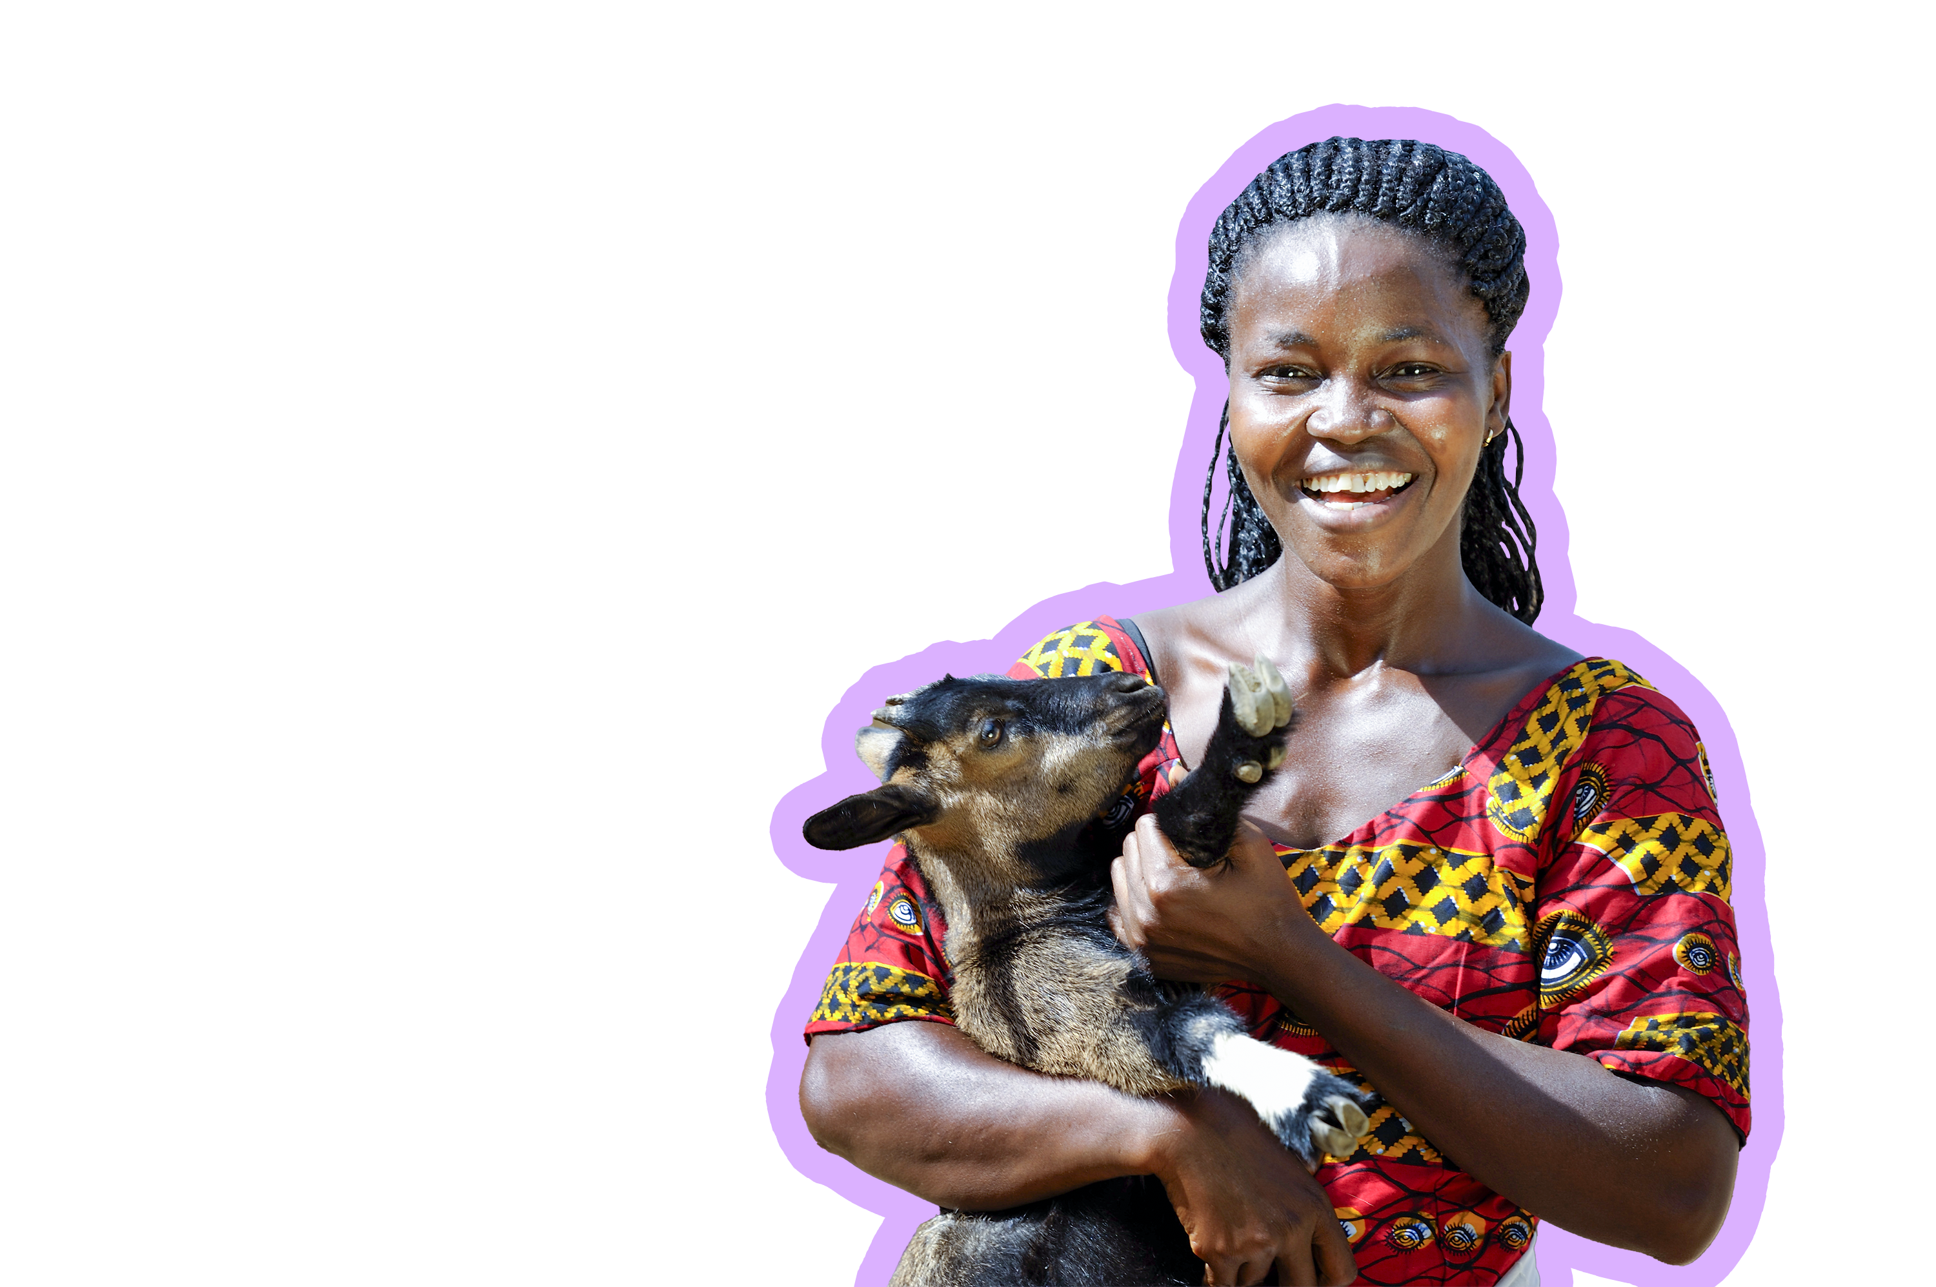
5 photos: Paul Jeffrey/Life on Earth
Sean Hawkey/Life on Earth

Slide 6
At the 2024 ELCA Youth Gathering, join ELCA World Hunger and commit to being part of the generation taking action to usher in a world without hunger and futures filled with hope.

Slide 7
Do you believe hunger has no place in our world?
Build Generation Zero-Hunger by joining youth around the country in a fundraising challenge to support ELCA World Hunger in advance of the ELCA Youth Gathering.
Paul Jeffrey/Life on Earth
ELCA.org/GenZeroHunger

Slide 8
Title
Additional Copy Here

