Slide 1
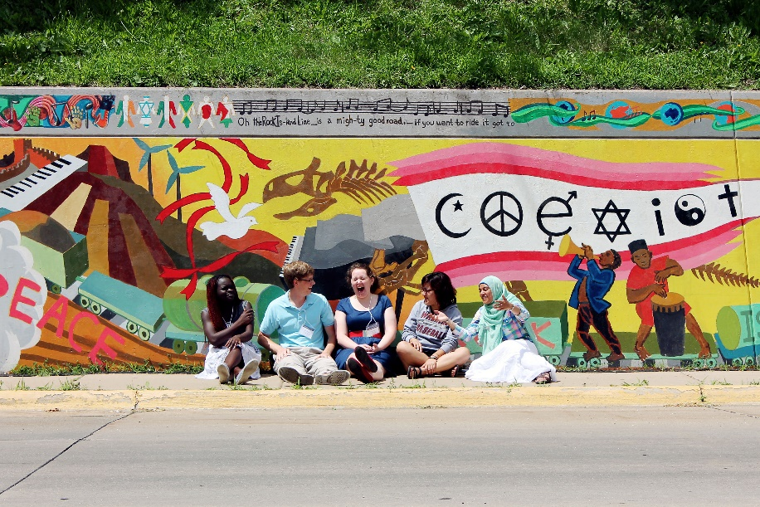
Engaging Others, Knowing Ourselves: A Lutheran Calling in a Multi-Religious World

Slide 2
Workshop Goals
To invite participants into an ELCA-wide conversation about our inter-religious calling and commitments.
To provide an overview of the book’s content.
To provide additional resources for study, dialogue, and engagement.

Slide 3
An Invitation
This book invites us all into conversation by challenging us to reflect on our past, learn from our present, and envision the future to which God is calling us. The heart of the book is the real-life case studies of inter-religious relations unfolding in a variety of ELCA ministry contexts. They encourage us to understand that our questions, doubts, and failures are as important as our answers, convictions, and successes. They challenge us to embrace that while there are a variety of responses to religious plurality, our common response is rooted in our Lutheran vocation – our response to God’s love in Jesus Christ.
Presiding Bishop Elizabeth A. Eaton, p. 6, Foreword

Slide 4
WHAT’S THE STORY BEHIND THE BOOK?
Photograph by Sarah Bromberger, Augustana College (Rock Island) class of 2016, of participants at the first Interfaith Understanding Conference, June 1-3, 2014. The mural, entitled Cadence of Diversity, was painted by more than 50 Augustana students in 2009-2010, led by art professor Peter Xiao, cover art.

Slide 5
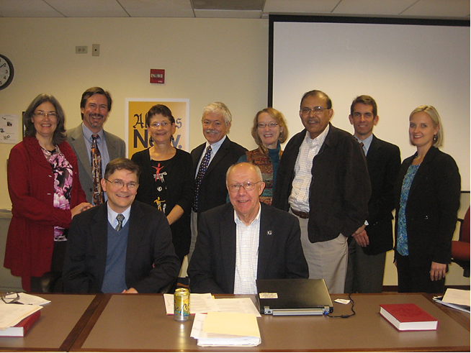
Background
In 2012 the ELCA Consultative Panels on Lutheran-Jewish and Lutheran-Muslim Relations met jointly to explore the theological and practical challenges of inter-religious relations across this church.
ELCA Lutheran-Jewish and Lutheran-Muslim Panel members, who began planning for this book in October 2012

Slide 6
Background
The panelists decided to invite people in a variety of ELCA ministry settings to share their stories and reflections.
A call for submissions went out across the church in early 2013.
Over fifty stories, or case studies, were received, while others were solicited.

Slide 7
Background
The panelists determined that there was a wealth of wisdom to share with the church, along with practical tips and historical analysis.
They set out to write a resource book.
Presiding Bishop Elizabeth Eaton offered her strong support, and Lutheran University Press agreed to publish the project.

Slide 8
WHAT’S IN THE BOOK?
Photograph by Sarah Bromberger, Augustana College (Rock Island) class of 2016, of participants at the first Interfaith Understanding Conference, June 1-3, 2014. The mural, entitled Cadence of Diversity, was painted by more than 50 Augustana students in 2009-2010, led by art professor Peter Xiao, cover art.

Slide 9
Content Overview
The book is divided into four chapters:
New Realities, New Thinking Since 1990
Guidelines for Interacting in the Real World
Exploring the Uncomfortable Questions: The Experience of Inter-Religious Work
Our God and Their God: A Relational Theology of Religious Plurality

Slide 10
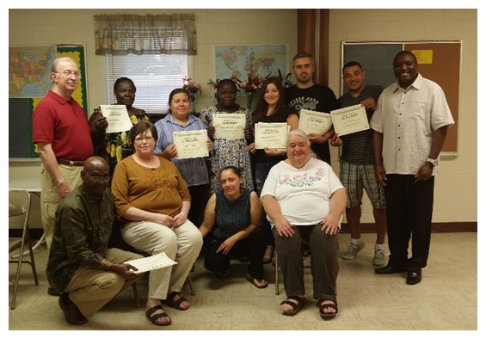
Content Overview
Additionally there are four sets of stand-alone case studies organized according to themes:
Mutual Hospitality
Peacebuilding and the Common Good
Campus Initiatives
Millennial Voices

Slide 11
HOW CAN IT BE USED?
Photograph by Sarah Bromberger, Augustana College (Rock Island) class of 2016, of participants at the first Interfaith Understanding Conference, June 1-3, 2014. The mural, entitled Cadence of Diversity, was painted by more than 50 Augustana students in 2009-2010, led by art professor Peter Xiao, cover art.

Slide 12
Approaches to Using the Book
The entire book can be read…
Those with less experience and those who want to explore what others are doing should start with chapters 1-2.
Those with more experience and those who want to think theologically should skip to chapters 3-4.
…or a single chapter or case study can be used.
Discussion questions are provided throughout.

Slide 13
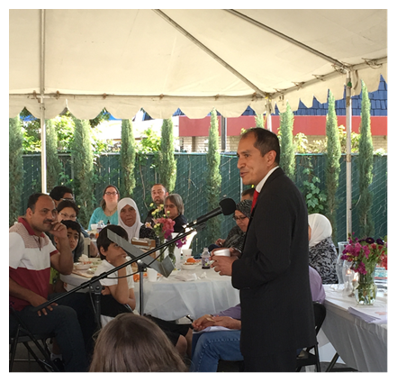
Approaches to Using the Book
The book can be used in various settings:
Individual study
Group study/adult forum
Rostered leader event
Youth retreat
College or seminary course
Lay school
Inter-religious study group
Community organization meeting
Service providers in-serving training

Slide 14
WHAT ARE THE BOOK’s
KEY INSIGHTS and questions?

Slide 15
Key Insights & Questions
The ELCA has a long history of inter-religious relations, especially:
Lutheran-Jewish Relations
Lutheran-Muslim Relations
Inter-religious dialogue and engagement in a multi-religious world can be understood as part of our vocational life.
There are already numerous examples of how the ELCA is participating in this work, which can provide key insights, learnings, and inspiration.

Slide 16
Key Insights & Questions
There are many reasons we should practice inter-religious dialogue and cooperation, including:
Our calling to serve our neighbor demands that we know our neighbor.
Our calling to defend our neighbor demands that we know our neighbor.
God is at work in the challenge of inter-religious relations.
Christians are called to be peacemakers.
Christian self-understanding is deepened and enhanced through engagement with others.
We are called to be good citizens, to serve the common good.

Slide 17
Key Insights & Questions
How should we engage with our non-Christian neighbors?
We are called to practice mutual hospitality.
What is a Christian view of other religions?
We can learn from revisiting scripture with new questions.
We ought to expect that we won’t have all the answers.
Dialogue is between people not religions.
We will learn about our own religion in the process.

Slide 18
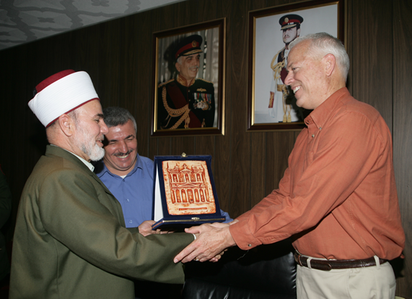
Key Insights & Questions
When planning inter-religious initiatives, consideration should be given to:
What have we learned?
What should we be careful about?
What might we try?
What should we be prepared for?
Gift giving after an inter-religious chaplaincy visit. Here the Mufti presents a gift showing Petra, a site visited during this trip to Chaplain (Colonel) Adams-Thompson with Chaplain (Major) Abdullah Hulwe translating in the background. In 2015 Abdullah was one of only six Muslim Imams in the United States Army.

Slide 19
Key Insights & Questions
What does it mean to be a Lutheran Christian in a multi-religious world?
We celebrate God’s unmerited grace, which gives us the freedom to err on the side of generosity.
We understand faith to be a matter of trust – trust in God, trust in God’s promises – rather than knowledge.
We are heirs to the theology of the cross, which calls us to recognize the limits of human knowing.
We are heirs to a lively sense of vocation – to a calling that focuses on serving the neighbor and the community.
We accept Luther’s distinction between two kingdoms, so that we are called to be citizens who care about all people in our communities.
We have the experience of being insiders/outsiders in our rapidly changing American culture, allowing us to relate to and empathize with others.

Slide 20
ADDITIONAL IDEAS & RESOURCES

Slide 21
Additional Ideas
The book provides a full guide on “Ways to Use this Book,” pp. 178-185
The book includes four sets of short, stand-alone case studies which can be used to engage in discussion about:
The inter-religious calling and commitments conveyed.
The theological and practical challenges that were faced.
Whether the outcome was a “success” or “failure.”
How this example could serve as a learning or model for engagement with one’s own community/context.

Slide 22
Additional Resources
See: “Helpful Websites,” pp. 190-191
Visit www.elca.org/ecumenical
Contact erinfo@elca.org

Slide 23
LET’S TRY THIS OUT: 4 SAMPLE CASE STUDY DISCUSSIONS

Slide 24
Sample Case Study Discussion 1 Mutual Hospitality
Have participants read: “Yom Kippur Mutual Hospitality Between Jews and Christians,” pp. 45-46.

Slide 25
Sample Case Study Discussion 1 Mutual Hospitality
In small groups discuss:
Were there risks taken by the Jews? By the Christians?
If so, how would you describe them?
Were they risks you would have been willing to take?
Describe a time when you asked for help from a neighbor.
Did this come naturally to you?
What was the outcome?
Would you do it again in the same way? If not, what would you change?

Slide 26
Sample Case Study Discussion 1 Mutual Hospitality
As a whole group discuss:
Are there neighbors of other religions in your community that need your help? Or that you need help from?
Who are they?
What kind of help do they/you need?
How might your community reach out to offer or request help?
What of our Lutheran tradition informs how we reach out to neighbors of other religions to:
Ask for help?
Offer help?
Close the discussion in prayer.

Slide 27
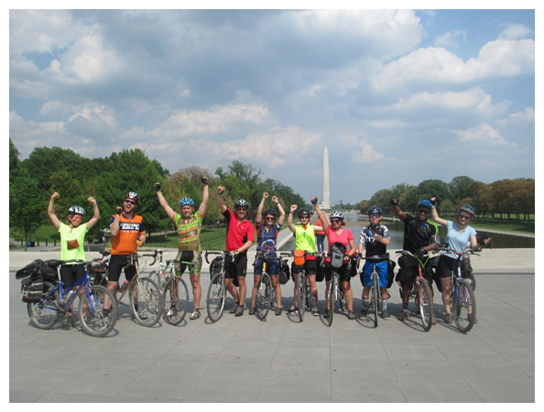
Sample Case Study Discussion 2 Peacebuilding and the Common Good
Have participants read: “People of Faith Responding to Climate Change” pp. 85-87.

Slide 28
Sample Case Study Discussion 2 Peacebuilding and the Common Good
Ask participants to think of a social issue about which they feel passionate.
Visit: http://elca.org/advocacy for ideas
Explore examples of inter-religious action for the common good from your city or state.
Visit: www.pluralism.org/interfaith
Google “interfaith” and your city/state

Slide 29
Sample Case Study Discussion 2 Peacebuilding and the Common Good
As a whole group discuss:
Are there issues we are being called to engage?
Who are our ecumenical and inter-religious partners?
What of our Lutheran tradition informs how we respond to the needs of our whole community?
Close the discussion in prayer.

Slide 30
Sample Case Study Discussion 3 Campus Initiatives
Have participants read: “Grounding Interfaith Engagement in Identity and Mission” pp. 112-113.

Slide 31
Sample Case Study Discussion 3 Campus Initiatives
In small groups discuss:
If you had been part of this process, would you have advocated for “guided by” or “because of”? Explain why. What do you think of the outcome?
Think of a time when you participated in a process that was more important than the outcome.
What did you learn?
Why was it important?

Slide 32
Sample Case Study Discussion 3 Campus Initiatives
As a whole group discuss:
How has your community become more religiously diverse? Where do you encounter this diversity?
What of our Lutheran tradition informs how we respond to this religious diversity?
Close the discussion in prayer.

Slide 33
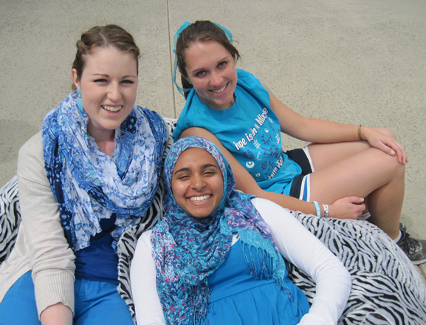
Sample Case Study Discussion 4 Millennial Voices
Have participants read: “Conflict During Dinner” pp. 161-164.
California Lutheran University Interfaith Allies Jamie, Shireen, and Rebecca share a moment during the IFYC’s #BeBlue #BetterTogether day in April 2013, gaining pledges for interfaith support while raising awareness for the upcoming Water Wise/Green Week campaign.

Slide 34
Sample Case Study Discussion 4 Millennial Voices
Many churches are concerned about how to engage youth and young adults, especially in light of recent statistics. http://www.pewforum.org/2012/10/09/nones-on-the-rise/
What do you think of Caleb’s explanation? (In sharing, prioritize young adult voices.)

Slide 35
Sample Case Study Discussion 4 Millennial Voices
Think of a time when you were in a diverse (inter-religious, cultural, racial, or ethnic) group.
What did you learn about others?
What did you learn about yourself?
What changed for you?
Do you agree that inter-religious engagement helps us to both learn about others and deepen our Lutheran faith? Why or why not?

Slide 36
Sample Case Study Discussion 4 Millennial Voices
What of our Lutheran tradition informs how we defend our neighbor’s faith?
Close the discussion in prayer.

Slide 37
QUESTIONS? IDEAS?

Slide 38
Thank you!
We are glad to provide additional support as you consider how you and your congregation or ministry might participate in this ELCA-wide conversation about our inter-religious calling and commitments.
Please contact me/us at: [your email, phone]

