Slide 1
Food for a Week An Interactive Simulation

Slide 2
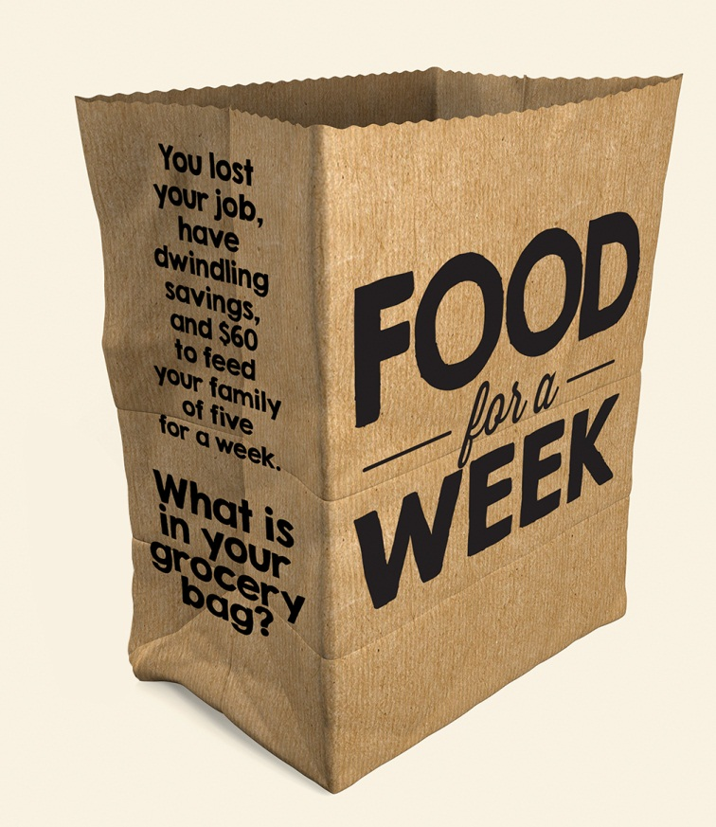
What is hunger? How do you feel when you are hungry?

Slide 3
Hunger
a compelling need or desire for food
painful sensation caused by lack of food
a shortage of food; famine

Slide 4
Food Security
exists when all people, at all times, have physical, social and economic access to sufficient, safe and nutritious food that meets their dietary needs and food preferences for an active and healthy life
Food and Agriculture Organization (United Nations)

Slide 5
Food Security
for a household means access by all members at all times to enough food for an active, healthy life; includes at a minimum:
The ready availability of nutritionally adequate and safe foods.
Assured ability to acquire acceptable foods in socially acceptable ways (that is, without resorting to emergency food supplies, scavenging, stealing, or other coping strategies
United States Department of Agriculture (USDA)

Slide 6
Food Security Levels
High food security — no problems, or anxiety about consistently accessing adequate food
Marginal food security — problems at times, or anxiety about, accessing adequate food, but the quality, variety, and quantity of food intake is not substantially reduced
Low food security — quality, variety, and desirability of diet is reduced, but the quantity of food intake and normal eating patterns are not substantially disrupted
Very low food security — At times during the year, eating patterns of one or more household members is disrupted and food intake reduced because the household lacks money and other resources for food.

Slide 7
What does food insecurity look like here?
Name of County
Number people in the SNAP program (Percentage of total population)
% trend (up or down) since 2000
Average monthly benefit: $ per person
Find data/screenshot for this slide at:
www.slate.com/articles/news_and_politics/map_of_the_week/2013/04/food_stamp_recipients_by_county_an_interactive_tool_showing_local_snap_data.html

Slide 8
Overall Rates of Food Insecurity
State data/screenshot for this slide at:
http://feedingamerica.org/hunger-in-america/hunger-studies/map-the-meal-gap.aspx

Slide 9
Food Insecurity Among Children
State data/screenshot for this slide at:
http://feedingamerica.org/hunger-in-america/hunger-studies/map-the-meal-gap.aspx
(click the “Child” tab to show the child food insecurity rates)

Slide 10
Simulation!
The Goal:
Feed your household for one week, staying within your budget, and making sure all of the members of your home have enough calories to meet their needs.

Slide 11
How it works:
Time: Insert time allotted for simulation
3 Stations:
Grocery store
Food pantry
Human services office

Slide 12
How it works:
During the simulation time you will acquire as much food as you can using your allotted income, and any assistance you are able to receive to meet your family’s caloric needs
Once you have completed this task, come back here and plan your meals for the week.

Slide 13
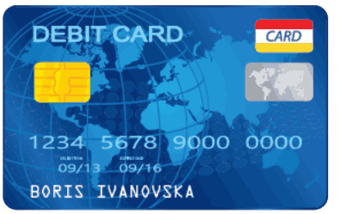
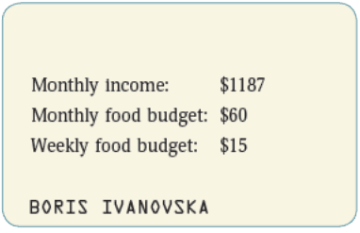
Debit cards
front of card
back of card

Slide 14
Discussion
How did it go? Were you able to feed your family on just your income?
What challenges did you face?
Were the SNAP and Food Pantry benefits helpful?
Do you think this was realistic? What other challenges might people face?

Slide 15
Discussion
The actual processing period for SNAP benefits is two to four weeks or more. How would that change the situation you were in tonight?
What did you learn that you would want others to know?
What can you do now?

Slide 16
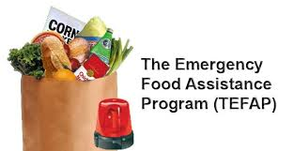
Government responses to hunger
Notes:
Supplemental Nutrition Assistance Program- SNAP
Women, Infants, and Children (WIC)
School and Summer Food Service Programs
The Emergency Food Assistance Program (TEFAP)
Community and Nutrition Program
Temporary Assistance for Needy Families (TANF)

Slide 17
Community Responses
Food depository
Food pantry
Meals on Wheels
Food recovery programs
Community kitchens
Food drives
Etc…

Slide 18
Get Involved
Tell other congregations about “Food for a Week”
Educate yourself and others — Food Stamp Challenge
Advocate
Volunteer
Raise money for ELCA World Hunger

Slide 19
Luke 14:15-24– A Great Dinner
¹⁶Then Jesus said to him, “Someone gave a great dinner and invited many. At the time for dinner he sent his servant to say to those who had been invited, ‘Come; for everything is ready now.’ But they all alike began to make excuses…
²¹ Then the owner of the house became angry and said to his servant, ‘Go out at once into the streets and alleys of the town and bring in the poor, the crippled, the blind, and the lame.’ And the servant said, ‘Sir, what you ordered has been done, and there is still room.’

Slide 20
Discussion
What behavior in this story would be considered unusual in our context?
What does this passage teach about hospitality?
How should we (and our congregations) understand what Jesus is saying about there being room at the table, and what does this have to do with hunger?

