Slide 2
2024-2025 Fund for Leaders
Full-tuition Scholarship Recipients

Slide 3
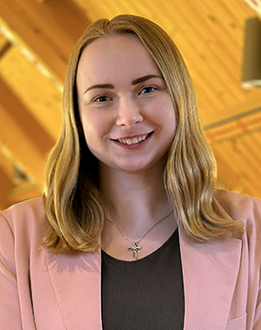
HAILEY BIANCO
Scholarship made possible by the Paul M. Dauten, Jr. Memorial
Endowment Fund
Synod: Metropolitan Chicago
Candidate for: Minister of Word and Service
Attending: Lutheran School of Theology at Chicago
What most excites you about starting seminary?
I’m most excited to be surrounded by a community of people that wants to see me succeed but also challenges me to push beyond my comfort zone.
FULL-TUITION SCHOLARSHIP RECIPIENT

Slide 4
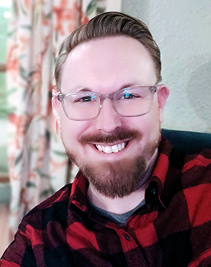
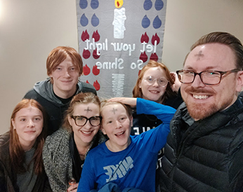
COLE CHAMBERS
Scholarship made possible by the John E. and
Marcia F. Grove Memorial Scholarship Fund
Synod: Rocky Mountain
Candidate for: Minister of Word and Sacrament
Attending: Luther Seminary
What most excites you about starting seminary?
I eagerly anticipate delving deeper into the study of Lutheran theology, embracing the challenge of expanding my understanding of faith. I am
excited to deepen my knowledge and explore ways to guide others toward
a meaningful and enriching discipleship to Jesus.
.
FULL-TUITION SCHOLARSHIP RECIPIENT

Slide 5
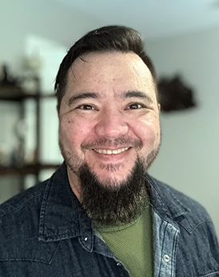
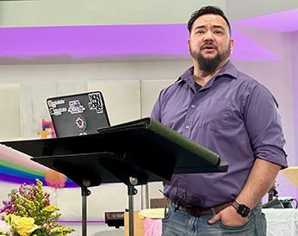
AARON COLWICK
Scholarship made possible by the Our Savior Vero Beach
Seminary Scholarship Fund
Synod: Northern Texas-Northern Louisiana
Candidate for: Minister of Word and Sacrament
Attending: Wartburg Theological Seminary
What most excites you about starting seminary?
I am eager to learn more about the passion I have had for Christ for
my whole life, and to see how Christ is eager to use that passion for
his ministry.
FULL-TUITION SCHOLARSHIP RECIPIENT

Slide 6
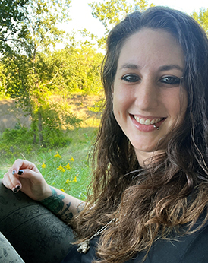
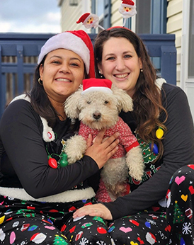
KRISTEN COMBS
Scholarship made possible by the Rev. Franklin G. Senger III
and Mr. Edward J. Wilhelm Seminary Scholarship
Endowment Fund
Synod: Metropolitan Chicago
Candidate for: Minister of Word and Sacrament
Attending: Lutheran School of Theology at Chicago
What most excites you about starting seminary? I am looking
forward to the formation, connection and growth that will come with
being a full-time seminary student.
FULL-TUITION SCHOLARSHIP RECIPIENT

Slide 7
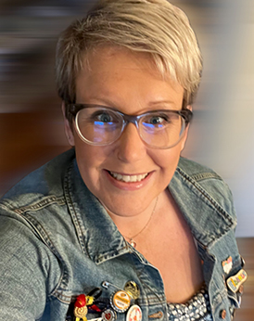
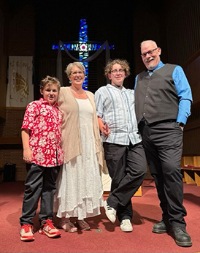
KATIE DYER
Scholarship made possible by the Omer G. and Annabelle K.
Voss Family Donor Advised Fund
Synod: Sierra Pacific
Candidate for: Minister of Word and Sacrament
Attending: Pacific Lutheran Theological Seminary
What most excites you about starting seminary?
I am so excited to start to tie my personal theological learning to my undergraduate, public university religious studies learning, and to
deepen my connection to Jesus and to my neighbors.
FULL-TUITION SCHOLARSHIP RECIPIENT

Slide 8
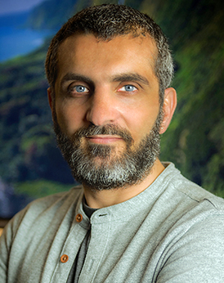
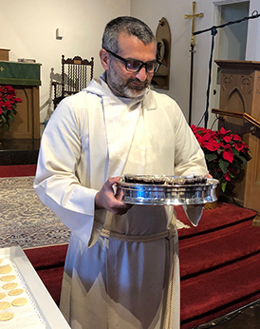
BILAL EL KAISSI
Scholarship made possible by the Omer G. and Annabelle K.
Voss Family Donor Advised Fund
Synod: Southwest California
Candidate for: Minister of Word and Sacrament
Attending: Pacific Lutheran Theological Seminary
What most excites you about starting seminary?
I’m looking forward to getting to know Jesus.
FULL-TUITION SCHOLARSHIP RECIPIENT

Slide 9
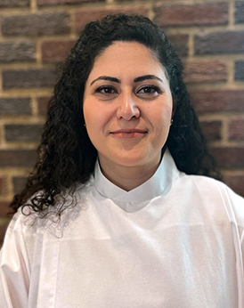
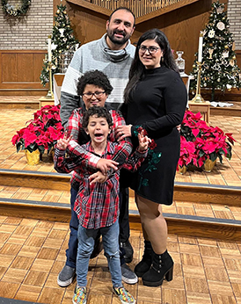
CLAUDINE ELZUGHBI
Scholarship made possible by the Arthur and Vera Mabis
Endowment Fund
Synod: Upstate New York
Candidate for: Minister of Word and Sacrament
Attending: Wartburg Theological Seminary
What most excites you about starting seminary?
I am eager to study the word of God deeper in my life and reflect it in people’s lives. I hope that studying in the seminary will help me practice Lutheran worship as a leader to a congregation in the future, and that I might learn how to be a role model for Palestinian Arab women in the Middle East.
FULL-TUITION SCHOLARSHIP RECIPIENT

Slide 10
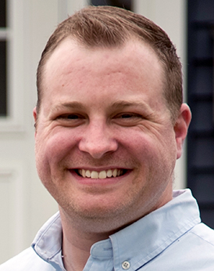
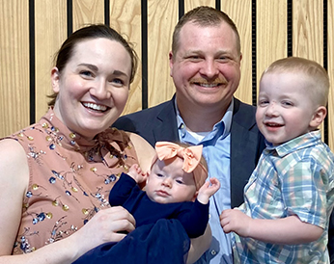
LEVI FAAS
Scholarship made possible by the Paul M. Dauten, Jr.
Memorial Endowment Fund
Synod: Southeastern Iowa
Candidate for: Minister of Word and Sacrament
Attending: Wartburg Theological Seminary
What most excites you about starting seminary?
I am most looking forward to growing in my knowledge of Scripture and leaning into the rhythms of intentional and consistent Christian
community. And I would like to try a large German beer at some point!
FULL-TUITION SCHOLARSHIP RECIPIENT

Slide 11
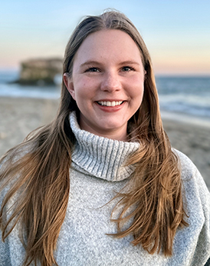
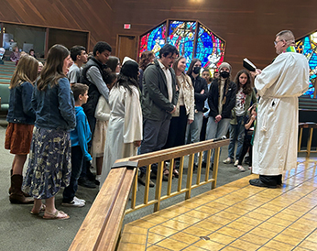
CHRISTIANA GARCIA
Scholarship made possible by the Dr. Adelia E. Weis
Memorial Ministerial Scholarship Fund
Synod: Sierra Pacific
Candidate for: Minister of Word and Sacrament
Attending: Luther Seminary
What most excites you about starting seminary?
I am thrilled to learn new pastoral care and preaching methods to
covey the sheer grace and love of God through Christ today!
FULL-TUITION SCHOLARSHIP RECIPIENT

Slide 12
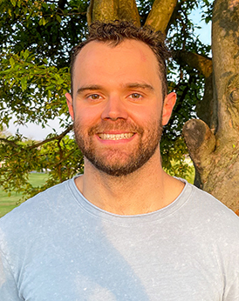
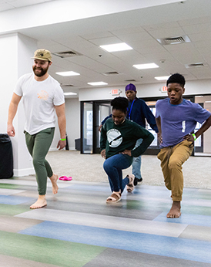
MATTHEW GROBINSKI
Scholarship made possible by the Rev. Guy Edmiston Mission
Endowment Fund
Synod: Lower Susquehanna
Candidate for: Minister of Word and Sacrament
Attending: Wartburg Theological Seminary
What most excites you about starting seminary?
I am most looking forward to diving headfirst into the big questions presented by our faith, exploring the many ways we can engage with and share the good news with others.
FULL-TUITION SCHOLARSHIP RECIPIENT

Slide 13
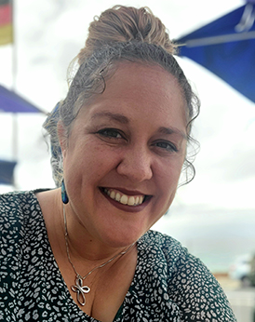
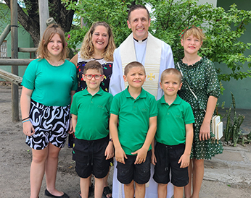
KELSEY GRULKE
Scholarship made possible by the Mr. and Mrs. Peter, William
and Esther Herlein Fund
Synod: Southeastern Iowa
Candidate for: Minister of Word and Sacrament
Attending: Luther Seminary
What most excites you about starting seminary?
I am most looking forward to growing new relationships with other
people who are passionate about God’s word and God’s kingdom.
FULL-TUITION SCHOLARSHIP RECIPIENT

Slide 14
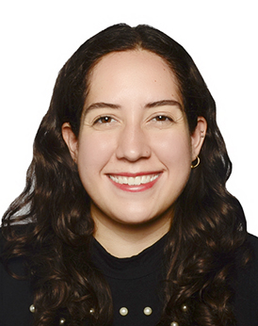
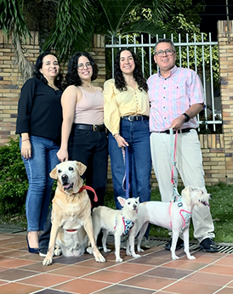
JULIANA JIMENEZ AREVALO
Scholarship made possible by the Merlin Flesner Memorial
Endowment Fund
Synod: South Dakota
Candidate for: Minister of Word and Sacrament
Attending: Wartburg Theological Seminary
What most excites you about starting seminary?
This year I fully commit to deepening my understanding and spiritual faith while connecting with and learning from influential leaders and guides in seminary and ministry. My goal is to build a stronger foundation for my comprehension of the Lutheran church in the U.S. and the teachings of God’s words, Jesus‘ example and the Holy Spirit.
FULL-TUITION SCHOLARSHIP RECIPIENT

Slide 15
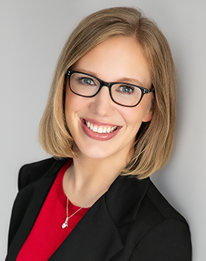
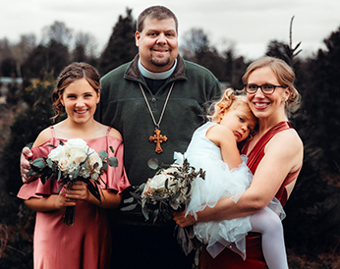
KRISTIN JOHNSON
Scholarship made possible by the George A. and Dorothy L.
Johnson Living Legacy Fund
Synod: Southwest California
Candidate for: Minister of Word and Sacrament
Attending: Wartburg Theological Seminary
What most excites you about starting seminary?
I am most looking forward to growing in my understanding of biblical
texts and interpretation as well as becoming more confident in leading, preaching, teaching and providing pastoral care.
FULL-TUITION SCHOLARSHIP RECIPIENT

Slide 16
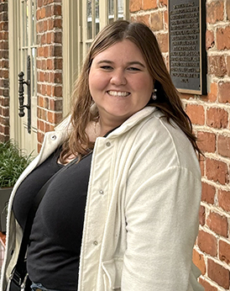
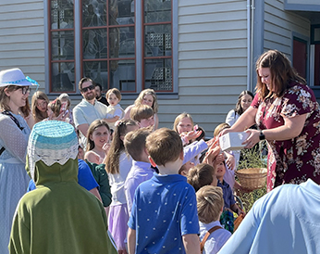
KALI KADELBACH
Scholarship made possible by the Corrine Wehvilainen
Memorial Endowment Fund
Synod: South Carolina
Candidate for: Minister of Word and Service
Attending: Wartburg Theological Seminary
What most excites you about starting seminary?
I look forward to deepening my understanding and connection to my faith through theological studies and spiritual formation.
FULL-TUITION SCHOLARSHIP RECIPIENT

Slide 17
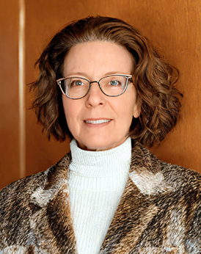
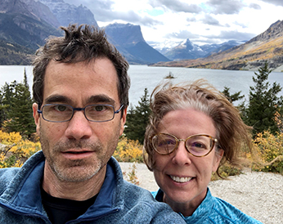
DARRA KINGSLEY
Scholarship made possible by the John E. and Marcia F. Grove
Memorial Scholarship Fund
Synod: Rocky Mountain
Candidate for: Minister of Word and Sacrament
Attending: Wartburg Theological Seminary
What most excites you about starting seminary?
I look forward to meeting others on the journey to ministry and learning together how to walk God’s path.
FULL-TUITION SCHOLARSHIP RECIPIENT

Slide 18
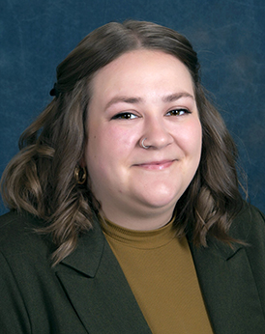
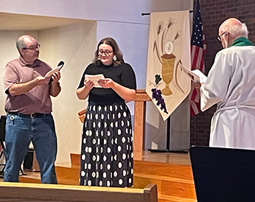
ALLISON KLEIN
Scholarship made possible by the Frances and Donna Olson
Seminary Scholarship Endowment Fund
Synod: Northwest Synod of Wisconsin
Candidate for: Minister of Word and Sacrament
Attending: Wartburg Theological Seminary
What most excites you about starting seminary?
I am looking forward to being in an intentional Christian community and growing alongside future leaders of the church.
FULL-TUITION SCHOLARSHIP RECIPIENT

Slide 19
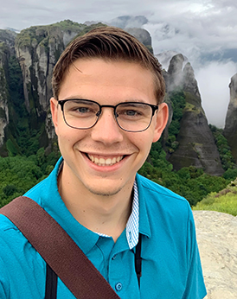
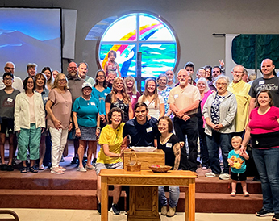
NATHANIEL KNUTSON
Scholarship made possible by the Abiding Savior Lutheran
Church Seminary Scholarship, Independence, MO
Synod: Northern Illinois
Candidate for: Minister of Word and Sacrament
Attending: Wartburg Theological Seminary
What most excites you about starting seminary?
As I start seminary, I am excited to be in a learning environment where everyone is passionate about theological study.
FULL-TUITION SCHOLARSHIP RECIPIENT

Slide 20
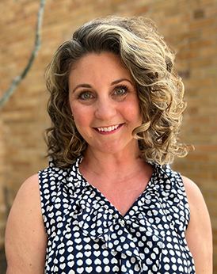
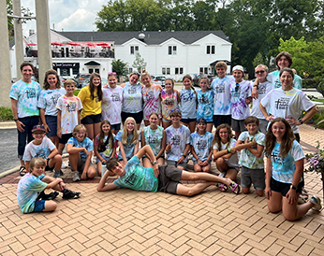
MICHELLE LATA
Scholarship made possible by the Rev. Milton Gustafson
Memorial Endowment Fund
Synod: Metropolitan Chicago
Candidate for: Minister of Word and Service
Attending: Luther Seminary
What most excites you about starting seminary?
I am most looking forward to connecting and engaging with others in a mission-driven setting by sharing new ideas and insights on how we are
called to do God’s work in the world.
FULL-TUITION SCHOLARSHIP RECIPIENT

Slide 21
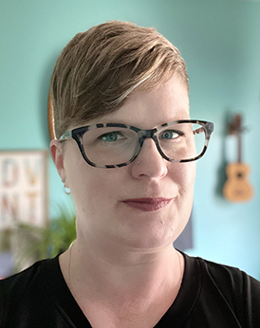
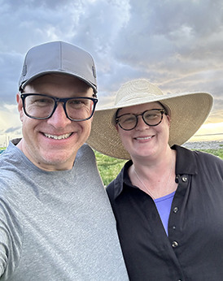
MEGANNE MASKO
Scholarship made possible by the E. Marilyn Oberle Seminary
Scholarship Endowment Fund
Synod: Indiana-Kentucky
Candidate for: Minister of Word and Service
Attending: Wartburg Theological Seminary
What most excites you about starting seminary?
I am looking forward to learning about different theologies and how they declare God’s love to God’s people.
FULL-TUITION SCHOLARSHIP RECIPIENT

Slide 22
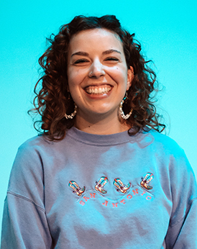
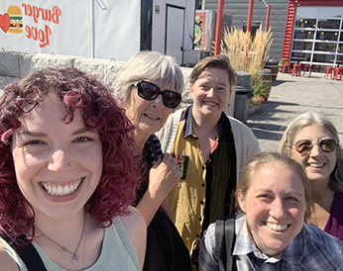
JULIA RANKIN
Scholarship made possible by the David D. and Barbara A.
Swartling Seminary Scholarship Fund
Synod: Oregon
Candidate for: Minister of Word and Service
Attending: Pacific Lutheran Theological Seminary
What most excites you about starting seminary?
I am looking forward to learning more about how the Bible and
Lutheranism are based in upending systems of oppression.
FULL-TUITION SCHOLARSHIP RECIPIENT

Slide 23
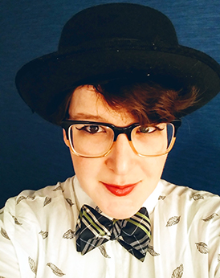
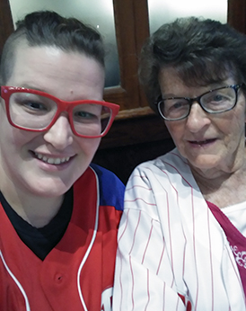
KELBY REED
Scholarship made possible by the Gunther C. and Johanna W.
Holpp Memorial Endowment Fund
Synod: Southeastern Pennsylvania
Candidate for: Minister of Word and Sacrament
Attending: Wartburg Theological Seminary
What most excites you about starting seminary?
I’m looking forward to adding to my spiritual tool kit and digging deeper into this mysterious experience we call faith.
FULL-TUITION SCHOLARSHIP RECIPIENT

Slide 24
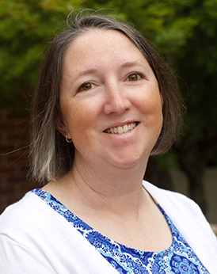
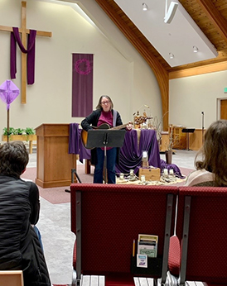
MARY RIEDL
Scholarship made possible by the ELCA Seminary Presidents
Fund for Leaders
Synod: Northwest Intermountain
Candidate for: Minister of Word and Sacrament
Attending: Luther Seminary
What most excites you about starting seminary?
I am really excited to connect with a community of people who want to learn more about how to lead the church and help them grow into relationship with God and their communities while adapting to a rapidly changing world.
FULL-TUITION SCHOLARSHIP RECIPIENT

Slide 25
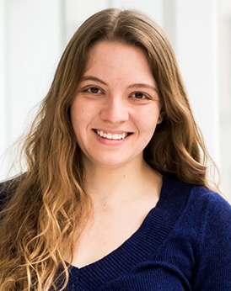
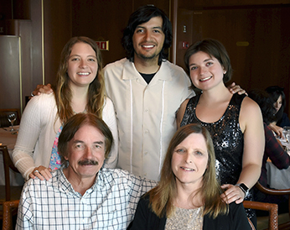
LINDSAY SANNEMAN
Scholarship made possible by the Dr. Carol Craig Seminary
Scholarship Endowment Fund
Synod: New England
Candidate for: Minister of Word and Sacrament
Attending: Pacific Lutheran Theological Seminary
What most excites you about starting seminary?
As I begin my seminary education, I am excited to continue to deepen my understanding of Scripture and the Lutheran tradition and to seek truth alongside a new community of fellow sinner-saints.
FULL-TUITION SCHOLARSHIP RECIPIENT

Slide 26
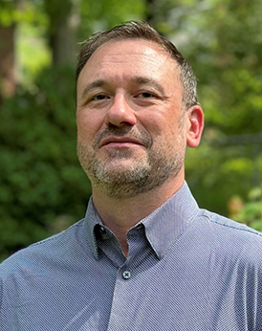
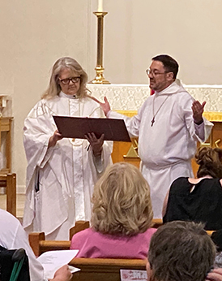
STEPHEN SCHRADER
Scholarship made possible by the A. Craig Settlage Memorial
Scholarship Endowment Fund
Synod: Southeastern
Candidate for: Minister of Word and Sacrament
Attending: Lutheran Theological Southern Seminary
What most excites you about starting seminary?
I am excited about investigating wider perspectives on theology and the interpretation of Scripture, and helping people know the God who wants to love each one of us; and I look forward to learning to care for God’s people in a way that shows that love.
FULL-TUITION SCHOLARSHIP RECIPIENT

Slide 27
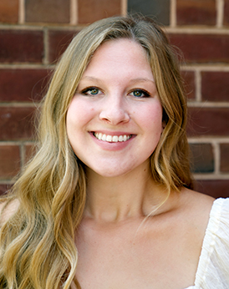
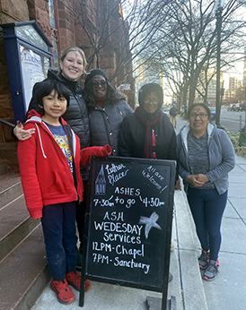
KARIN SELLAND
Scholarship made possible by the Rev. Daniel W. and Karen
Erlander Seminary Scholarship Fund
Synod: Western North Dakota
Candidate for: Minister of Word and Sacrament
Attending: Pacific Lutheran Theological Seminary
What most excites you about starting seminary?
As I look ahead toward seminary, I am most excited for the
opportunity to be surrounded by other people of faith. I am excited for the chance to learn from excellent professors, delve into new texts and strengthen my relationship with God throughout it all.
FULL-TUITION SCHOLARSHIP RECIPIENT

Slide 28
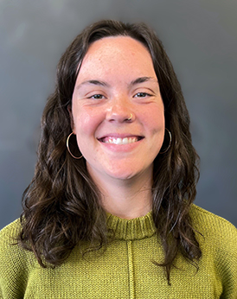
ELLIE TAYLOR
Scholarship made possible by the Jutta F. Anderson Seminary Scholarship Fund
Synod: Northeastern Iowa
Candidate for: Minister of Word and Service
Attending: Wartburg Theological Seminary
What most excites you about starting seminary?
I am ecstatic to have the opportunity to grow in knowledge of God and Scripture in order to care effectively and authentically for all creation: land, human and more than human.
FULL-TUITION SCHOLARSHIP RECIPIENT

Slide 29


CYNTHIYA VARGHESE
Scholarship made possible by the Rev. Ronald T. and Sue Ann
Glusenkamp Seminary Scholarship
Synod: Metropolitan Chicago
Candidate for: Minister of Word and Sacrament
Attending: Lutheran School of Theology at Chicago
What most excites you about starting seminary?
To serve God and the people of God faithfully with love and justice.
FULL-TUITION SCHOLARSHIP RECIPIENT

Slide 30

TAMIKA WELLS
Scholarship made possible by the William D. Wubben
Memorial Endowment Fund
Synod: North Carolina
Candidate for: Minister of Word and Sacrament
Attending: Wartburg Theological Seminary
What most excites you about starting seminary?
I most look forward to learning about God from God’s heart, by the Holy Spirit, in the languages God chose to share God’s mind with us, Greek and Hebrew. I look forward to community, joyful worship and ministry together with like-minded souls.
FULL-TUITION SCHOLARSHIP RECIPIENT

Slide 31


CALISTA WOLF
Scholarship made possible by the Rev. Jeanette Bialas
Strandjord Seminary Scholarship Endowment Fund
Synod: Northwestern Minnesota
Candidate for: Minister of Word and Sacrament
Attending: Luther Seminary
What most excites you about starting seminary?
I am looking forward to have the opportunity to explore where God is
calling me!
FULL-TUITION SCHOLARSHIP RECIPIENT

Slide 32
Congratulations!

Slide 33
2024-2025 Fund for Leaders
Mission Developer
Scholarship Recipients

Slide 34

JADHER ABAD
Scholarship made possible by the Delilah E. Ross Memorial
Endowment Fund
Synod: Texas-Louisiana Gulf Coast
Candidate for: Minister of Word and Sacrament
Attending: Pacific Lutheran Theological Seminary
What most excites you about seminary?
I look forward to continuing to develop my Lutheran theology to better serve and educate my community.
MISSION DEVELOPER SCHOLARSHIP RECIPIENT

Slide 35


CATHERINE ABIHUDI
Scholarship made possible by the Elizabeth K. Weisburger
Mission Developer Seminary Scholarship Fund
Synod: Metropolitan Chicago
Candidate for: Minister of Word and Sacrament
Attending: Lutheran School of Theology at Chicago
What most excites you about seminary?
I am looking forward to learning more on how dynamic theology is relevant
to the communities I serve.
MISSION DEVELOPER SCHOLARSHIP RECIPIENT

Slide 36


JUAN CABRERA
Scholarship made possible by the MIF Mission Developers
Seminary Scholarship Fund
Synod: South-Central Synod of Wisconsin
Candidate for: Minister of Word and Sacrament
Attending: Wartburg Theological Seminary
What most excites you about seminary?
What I’m most looking forward to is continuing to discover Jesus
through every person that crosses my journey and learning from their experiences as they learn from my Latino heritage.
MISSION DEVELOPER SCHOLARSHIP RECIPIENT

Slide 37


ANDREA ELLIOTT
Scholarship made possible by the Sara E. and John R. Wise
Mission Developer Seminary Scholarship Fund
Synod: Southwestern Texas
Candidate for: Minister of Word and Sacrament
Attending: Pacific Lutheran Theological Seminary
What most excites you about seminary?
I look forward to my pastoral formation being the embodiment of a
pastor-organizer such as Jesus.
MISSION DEVELOPER SCHOLARSHIP RECIPIENT

Slide 38


ADAM GROENKE
Scholarship made possible by the Rev. Dr. Lauritz and
Mrs. Margaret Vigness Mission Developer Scholarship Fund
Synod: Northeastern Pennsylvania
Candidate for: Minister of Word and Sacrament
Attending: Lutheran School of Theology at Chicago
What most excites you about seminary?
This coming year I am most looking forward to my study tour to Turkey and Greece, walking in the footsteps of the apostle Paul.
MISSION DEVELOPER SCHOLARSHIP RECIPIENT

Slide 39


APRIL MULVEY
Scholarship made possible by the George and Frances Cornell
Family Mission Developer Seminary Scholarship Fund
Synod: Sierra Pacific
Candidate for: Minister of Word and Sacrament
Attending: United Lutheran Seminary
What most excites you about seminary?
I dream big and serve an even bigger God; I am looking forward to what God has in store for me this year.
MISSION DEVELOPER SCHOLARSHIP RECIPIENT

Slide 40
Congratulations!

Slide 41
2024-2025 Fund for Leaders
Federal Chaplaincy
Scholarship Recipients

Slide 42


ADRIANO AYRES
Scholarship made possible by the 1927 St. John West
Milwaukee, WI Endowment Fund and the Chaplain Eric and
Mrs. Paula Wester Chaplaincy Scholarship Fund
Synod: South-Central Synod of Wisconsin
Candidate for: Minister of Word and Sacrament
Attending: Wartburg Theological Seminary
What most excites you about starting seminary?
I want to learn as much as I can about how to serve in a military setting
and small parish ministry.
FEDERAL CHAPLAINCY SCHOLARSHIP RECIPIENT

Slide 43


CHELSEY HINRICHSEN
Scholarship made possible by the Rev. Scottie and Karen
Lloyd Chaplaincy Seminary Scholarship and the Thomas J.
Anders and Gerald E. Lloyd Memorial Chaplaincy Scholarship
Synod: Pacifica
Candidate for: Minister of Word and Service
Attending: Pacific Lutheran Theological Seminary
What most excites you about starting seminary?
I am most looking forward to deepening and widening my understanding
of the mystery that is God and all the ways that mystery presents itself in
our daily lives so that I can help bring healing to the hurting.
FEDERAL CHAPLAINCY SCHOLARSHIP RECIPIENT

Slide 44


REBEKAH MILLER
Scholarship made possible by the ELCA Federal Chaplaincy
Scholarship Fund and the Colonel Robert A. Williamson,
M.D. Scholarship
Synod: Sierra Pacific
Candidate for: Minister of Word and Sacrament
Attending: Pacific Lutheran Theological Seminary
What most excites you about starting seminary?
I am most looking forward to the opportunity of building relationships with my cohort and experiencing seminary with all the gifts it can bring and how I can best utilize my time at seminary.
FEDERAL CHAPLAINCY SCHOLARSHIP RECIPIENT

Slide 45


CHRISTOPHER SCHOMAKER
Scholarship made possible by the Rev. Ivan and Kathryn Ives
Federal Chaplaincy Seminary Scholarship and the
Rev. Murray D. and Rhoda M. Finck Federal Chaplaincy
Seminary Scholarship Fund
Synod: Northeastern Pennsylvania
Candidate for: Minister of Word and Sacrament
Attending: United Lutheran Seminary
What most excites you about starting seminary?
I am so blessed with the opportunity to be in an environment teeming with other disciples of Christ as I pursue my dream of becoming a chaplain in the U.S. military.
FEDERAL CHAPLAINCY SCHOLARSHIP RECIPIENT

